Slide 1



Provider Training Toolkit on Use of Oral and Long-acting HIV Pre-Exposure Prophylaxis (PrEP)
LESSONS 1-4
LENACAPAVIR-FOCUSED LEARNING PATHWAY

Slide 2

Provider Training Toolkit on Use of Oral and Long-acting HIV Pre-Exposure Prophylaxis (PrEP)
LESSON 1: LEN FORMULATIONS AND EVIDENCE FOR PROTECTION AGAINST HIV

Slide 3

LEARNING OBJECTIVES
Upon completion of Lesson 1, you should be able to:
Define pre-exposure prophylaxis (PrEP) and differentiate PrEP from post-exposure prophylaxis (PEP) and antiretroviral therapy (ART)
Identify how LEN is formulated and delivered
Describe how LEN is packaged and needs to be stored
Describe the evidence that LEN protects against HIV

Slide 4

How do antiretroviral (ARV) medications work against HIV?
ARV medications work against HIV by interfering with proteins the viruses needs to replicate.
Different ARVs work against different proteins

Slide 5

ARV Medications are used in different ways for different purposes,
Let’s define important terminology

Slide 6

Pre-exposure prophylaxis (PrEP)
When people who are HIV-negative start using ARVs before exposure to protect against HIV, that is called pre-exposure prophylaxis (PrEP).

Slide 7

Post-exposure prophylaxis (PEP)
When people who are HIV-negative start using ARVs after exposure to protect against HIV, that is called post-exposure prophylaxis (PEP).

Slide 8

Anti-retroviral treatment (ART)
When people living with HIV use ARVs to suppress viral load, that is called antiretroviral therapy (ART).

Slide 9

PrEP
PEP
ART
ARVs Started Before Exposure to Prevent HIV
ARVs Started After Exposure to Prevent HIV
Use of ARVs to Suppress Viral Replication
When people who are HIV-negative start using ARVs before exposure to protect against HIV, that is called pre-exposure prophylaxis (PrEP).
When people who are HIV-negative start using ARVs after exposure to protect against HIV, that is called post-exposure prophylaxis (PEP).
When people living with HIV use ARVs to suppress viral load, that is called antiretroviral therapy (ART).

Slide 10

Who may benefit from HIV PrEP?
HIV PrEP is recommended as an additional choice to prevent HIV among those at substantial risk of HIV
Providers should describe the potential benefits of PrEP and offer it to those who may benefit, as part of a comprehensive approach to preventing HIV, as well as other sexual and reproductive health and other health services.
HIV PrEP only protects against HIV. It does not prevent pregnancy or other STIs. Condoms and contraceptive products should be used for prevention of pregnancy or other STIs as needed.
Also - Providers should give PrEP to any client who requests it as long as they're clinically eligible, regardless of or in the absence of other reported risk factors.
Clients may not be able to or may not wish to disclose the reasons they’re requesting PrEP.

Slide 11
There are multiple PrEP products recommended by WHO for HIV Prevention,
Let’s review the recommended PrEP products

Slide 12




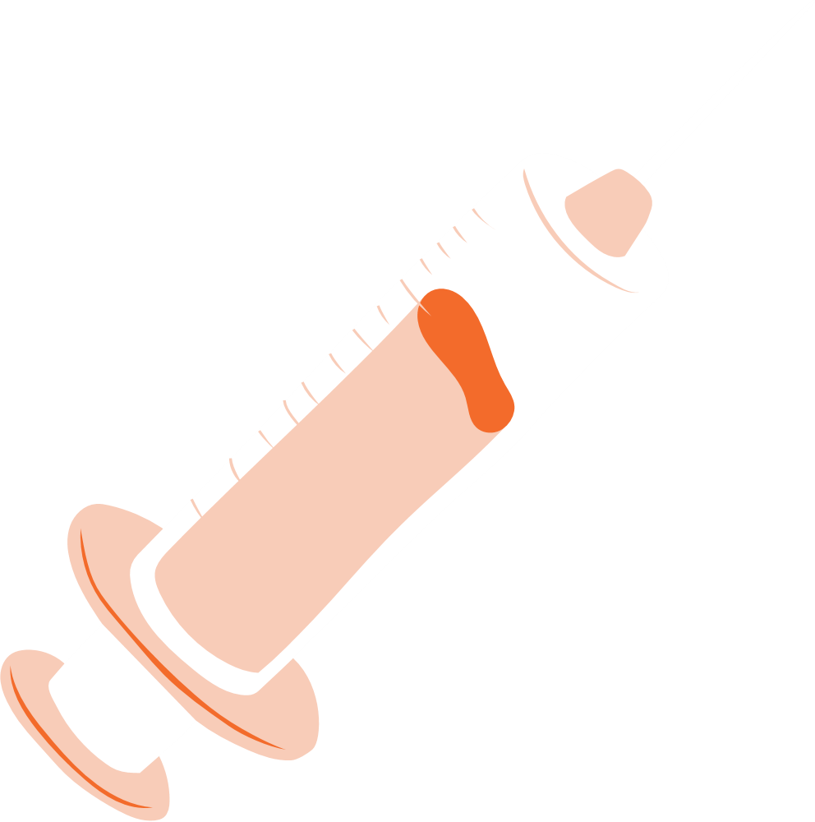
WHO recommended HIV PrEP Products:
Oral PrEP
containing Tenofovir
(TDF-based oral PrEP)
Dapivirine Vaginal Ring (DVR)
Long-acting Injectable Cabotegravir
(CAB-LA)
Long-acting Injectable Lenacapavir (LEN)
C
L
Note: not all PrEP products are available in all countries. Refer to national policies and guidelines to determine which HIV PrEP options are available locally.

Slide 13
This training focuses exclusively on long-acting injectable Lenacapavir (LEN)
L

Slide 14
PrEP Product Formulation & Delivery

Slide 15

Long-acting Injectable Lenacapavir (LEN)
LEN is manufactured and packaged in two different formulations.
Lenacapavir (LEN) is a liquid solution in a vial that is injected subcutaneously. Each vial contains 1.5 ml of a liquid suspension equating to 463.5 mg of lenacapavir.
Oral LEN is a pill that is taken by mouth. Each pill contains 300 mg of lenacapavir.
L

Slide 16






As the lenacapavir concentration in the body increases after injection...
cells throughout the body become better protected against HIV

Slide 17

Lenacapavir is a type of medication known as capsid inhibitor
Capsid is a protein that is needed by HIV to replicate.
Lenacapavir interferes with the functioning of the capsid proteins– thus protecting against HIV infection throughout the body.
Note: People who inject drugs (PWID) were not explicitly included in research trials on LEN, but existing drug level data suggest that commonly injected drugs likely do not affect LEN levels. A study is ongoing to compare LEN levels in PWID with other groups who could benefit from PrEP.

Slide 18
LEN Product Storage

Slide 19

How do PrEP Products need to be stored?
The manufacturers of each PrEP product provide storage information and conditions that must be followed, including acceptable storage temperatures.
All medicines should be stored out of the reach of children, and in a secure and dry location.
Refrigeration is not required to store any PrEP product.

Slide 20
LEN Liquid Suspension Storage
Remember, LEN is manufactured and packaged in two different formulations
LEN liquid suspension is provided in a single-use glass vial, enclosed within an outer package to protect the contents from light.
A given 1.5 ml injection should be sourced from a single vial only (not sourced from multiple vials), and the liquid solution in a vial should not be mixed with any other product or diluent
Vials must be kept in the original carton until just prior to injection preparation to protect from light. Once the solution has been drawn into the syringe, the injection should be administered as soon as possible
The vial should not be used if the expiry date has passed.
L

Slide 21
Oral LEN Storage
LEN pills (300mg) are packaged in plastic bottles, each containing 4 pills of LEN, and should be dispensed in their original container
Plastic bottles include a desiccant to regulate humidity, which should remain in place until the pills are completely used
Bottles should remain tightly closed, and should not be opened until ready for use
Pills should not be used if the packaging seal is broken or missing, or if the expiry date has passed.
L

Slide 22

LEN Storage
LEN vials, bottles and blister packs should be stored at:
20-25°C (up to 30°C is permitted)
68-77°F (up to 86°F is permitted)
Do not freeze the vials.
LEN should not be refrigerated.
L

Slide 23
Evidence that LEN as PrEP Works

Slide 24

Evidence that LEN Protects Against HIV
Regardless of the PrEP product, clients achieve greater protection against HIV when they use their preferred PrEP product as instructed. We’ll review the ideal timing and frequency of use of each product in detail in Lesson 2.

Slide 25

Evidence that LEN Protects Against HIV
Clinical trials of LEN conducted across diverse populations compared the rate of HIV infection in those receiving LEN in two ways: 1) to background HIV incidence rates, in lieu of placebo; and, 2) to the rate of HIV infection in those randomized to receive TDF-based oral PrEP.
The reduction in HIV risk from sexual exposure among those who received LEN varied by participant sex/gender (and comparison group):
CISGENDER WOMEN:
HIV infection rate among those using LEN was 100% lower than the background rate of HIV and 100% lower than in those receiving TDF-based oral PrEP.
CISGENDER MEN, TRANSGENDER WOMEN, TRANSGENDER MEN, AND GENDER NON-BINARY PERSONS:
HIV infection rate among those using LEN was 96% lower than the background HIV incidence and 89% lower than in those receiving TDF-based oral PrEP.
L

Slide 26
Additional Details: LEN Research
People who inject drugs (PWID) were not explicitly included in research trials on LEN, but existing drug level data suggest that commonly injected drugs likely do not affect LEN levels. A study is ongoing to compare LEN levels in PWID with other groups who could benefit from PrEP.

Slide 27

Remember, All PrEP products yield better protection when a client is using their preferred product as instructed. Missing doses or incorrect, inconsistent or delayed use may result in less protection.

Slide 28
Summary of LEN as PrEP Evidence
When doses are administered correctly and on schedule, LEN reduces the risk of HIV infection from all forms of sex by:
100% in cisgender women compared to the background rate of HIV (and compared to those receiving TDF-based oral PrEP)
96% in cisgender men, transgender women, transgender men and gender non-binary persons compared to the background HIV incidence rate (and 89% compared to those receiving TDF-based oral PrEP)

Slide 29





Summary of Key Points in Lesson 1
ARVs interfere with the function of proteins needed by HIV to replicate, and so may be used to prevent or treat HIV infection.
When HIV-negative individuals start ARVs before potential exposure to HIV, such use is referred to as pre-exposure prophylaxis (PrEP).
There are 4 HIV PrEP products currently recommended by WHO: TDF-based oral PrEP, Dapivirine Vaginal Ring (DVR), long-acting injectable cabotegravir (CAB-LA) and lenacapavir (LEN); availability may vary by country.
The packaging of each PrEP product is specified by the manufacturer; packages of bottles, boxes or vials should be stored in secure, dry locations. None of them requires refrigeration, though each has a specified temperature range for storage.
All PrEP products provide greater protection against HIV when used as instructed. Missing doses or incorrect, inconsistent, or delayed use may result in less or no protection.

Slide 30
Specifics by PrEP Product are as follows:
LEN
LEN is available as both a liquid solution containing lenacapavir injected subcutaneously and as a pill taken by mouth.
Research evidence indicates LEN, when used as directed, reduces the risk of acquiring HIV from all forms of sex:
In cisgender women: 100% compared to the background rate of HIV (and to those receiving TDF-based oral PrEP).
In cisgender men, transgender women, transgender men, and gender non-binary persons: 96% compared to the background rate of HIV (and 89% compared to those receiving TDF-based oral PrEP).
People who inject drugs (PWID) were not explicitly included in research trials on LEN, but existing drug level data suggest that commonly injected drugs likely do not affect LEN levels. A study is ongoing to compare LEN levels in PWID with other groups who could benefit from PrEP.

Slide 31

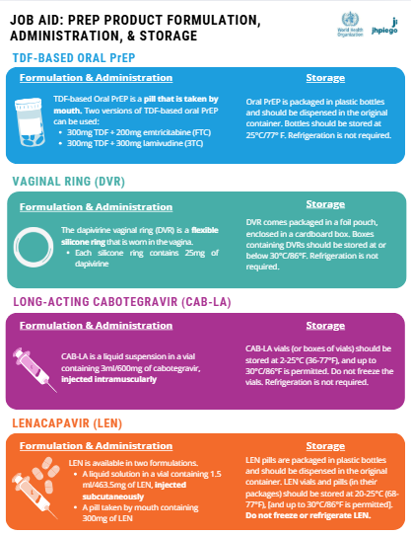
Downloadable Resources for Lesson 1:
The information presented in this lesson is summarized in the resource titled: Job AId: PrEP Product Formulation, Administration, & Storage which is available for download

Slide 32

Provider Training Toolkit on Use of Oral and Long-acting HIV Pre-Exposure Prophylaxis (PrEP)
LESSON 2: DETERMINING LEN CLINICAL ELIGIBILITY/ASSESSING FOR CONTRAINDICATIONS

Slide 33
LEARNING OBJECTIVES
Upon completion of Lesson 2, you should be able to:
Identify the steps taken to clinically assess eligibility to start PrEP
Define contraindications to use of LEN for PrEP
Give examples of clinical management options when contraindications are identified

Slide 34
What steps are taken to assess whether a client is clinically eligible to start a PrEP product?
In this lesson we’ll cover how to assess whether a client may safely and effectively use a PrEP product (is “clinically eligible”), once a suitable product has been chosen based upon needs and preferences.

Slide 35

What steps are taken to assess whether a client is clinically eligible to start a PrEP product?
Once the preferred PrEP product has been identified, providers must ensure the client is clinically eligible to start using it.
There are multiple clinical assessment steps that should be completed to determine such eligibility.
Some steps are common across all PrEP products, while others are product-specific.
Note: This lesson addresses clinical assessment of eligibility before a client starts PrEP. Reassessment for any new contraindications arising in a client wishing to continue using PrEP is addressed separately in Lesson 4.

Slide 36

Steps to Assess Clinical Eligibility
Providers should assess the following to determine eligibility for use of any PrEP product:
HIV Testing
Possible exposure to HIV in the past 72 hours (“PEP Assessment”)
Signs/symptoms of acute HIV infection in past 2 weeks in the context of possible HIV exposure(s) in past 1 month ("AHI Assessment")
Use of other medications or products that may interact with PrEP
Medication allergies/hypersensitivities
Comorbidities
Assessment may include diagnostic test(s), medical history, and/or physical examination. It is often possible to perform eligibility assessment steps virtually through differentiated delivery options, as suggested in the WHO Technical Brief: Differentiated and simplified pre-exposure prophylaxis for HIV prevention: Update to WHO implementation guidance.

Slide 37

PrEP Use in Pregnancy
All PrEP products are considered by WHO to be safe and effective for use by pregnant and breastfeeding individuals, though evidence for dapivirine vaginal ring (DVR), CAB-LA, and lenacapavir (LEN) is more limited in comparison to TDF-based oral PrEP.
In some countries, national regulatory bodies and policies may have additional guidance or contraindications for pregnancy or breastfeeding and for starting and/or continuing specific PrEP products, and pregnancy testing may be required in such locations. Providers should refer to the guidelines and policies in their country on this topic.
None of the PrEP products is known to interact with medications and dietary supplements commonly used during pregnancy and the postnatal period, including iron and folic acid tablets, antibiotics, antimalarials, antihelminthics, and oxytocin. It is safe to use these while also using HIV PrEP, regardless of the specific product. Most family planning methods and PrEP may be used in combination; concomitant use of more than one vaginal ring (e.g., for PrEP and family planning) should be avoided.

Slide 38
Ruling-out HIV Infection
PrEP is only appropriate for those who are HIV-negative, so all clients should be thoroughly assessed for HIV status. Steps 1-3 focus on ruling out HIV infection
HIV Testing
Possible exposure to HIV in the past 72 hours (“PEP Assessment”)
Signs/symptoms of acute HIV infection in past 2 weeks in the context of possible HIV exposure(s) in past 1 month ("AHI Assessment")
HIV testing (Step 1) alone is not sufficient, since all HIV diagnostic tests have window periods when early HIV infection cannot be detected, when they may yield false-negative results. As a result, providers must complement HIV testing with additional clinical and behavioral assessments to further rule out HIV infection prior to starting a client on PrEP.
This includes assessing HIV exposure in the prior 72 hours/"PEP assessment" (Step 2) and assessing signs/symptoms of AHI in the past 2 weeks in the context of HIV exposure in the past 1 month/"AHI assessment" (Step 3).

Slide 39

Identifying early/pre-existing HIV infection among clients seeking PrEP is important, since inadvertently starting PrEP in individuals living with HIV may result in negative clinical outcomes, including:
Delayed start of ART. Individuals living with HIV should be initiated on antiretroviral therapy (ART) without delay to suppress viral replication; PrEP products are not sufficient to treat HIV.
Delayed detection of HIV by HIV tests, depending upon the PrEP product.
Risk of developing viral drug resistance, depending upon the PrEP product.

Slide 40
Additional details: Delayed HIV Detection Risk
Systemically-acting PrEP products can or may result in a delayed ability of HIV tests to detect HIV; DVR use does not.
LEN
There has been no evidence of delayed HIV detection in trials to date based on the laboratory-based nucleic acid testing (NAT) approaches used.
Due to the long-acting nature of LEN, diagnostic challenges may theoretically occur, given the medication’s long half-life and antiviral activity for up to 12 months after the last dose. This would be similar to other systemically-acting PrEP products.
L

Slide 41
Additional details: Drug Resistance Risks
Like some other PrEP products, LEN use is known to result in the development of HIV drug resistance.
LEN
Starting LEN in individuals living with HIV can result in the development of viral drug resistance.
It’s possible LEN resistance could render LEN or other future capsid inhibitor medications less effective at treating HIV. However, since capsid inhibitors are not routinely used in HIV treatment regimens, the implications to clinical care should be minimal.
L

Slide 42


Step 1: Test for HIV
Since PrEP may only be safely and effectively used by those who are HIV negative, all clients must test for HIV before starting PrEP, using the HIV diagnostic tests specified in each country’s national HIV testing algorithm. Ideally, HIV testing should be conducted on the day the client intends to start PrEP, to facilitate same-day PrEP initiation.
Note about HIV self-testing (HIVST): WHO recommends that HIVST may be considered for those seeking to start TDF-based oral PrEP or DVR (but not for CAB-LA or LEN) to simplify and support differentiated service delivery for PrEP. Providers wishing to include HIVST as part of their clinical assessment of eligibility should follow national guidelines in their country.

Slide 43


Step 2: Possible exposure to HIV in past 72 hours (“PEP Assessment”)
Because individuals who have acquired HIV may still test negative due to testing window periods, providers should further assess whether clients may have been exposed to HIV in the past 72 hours, as post-exposure prophylaxis (PEP) may be indicated (instead of PrEP). Whether PEP is indicated is a decision based upon the likelihood of exposure, and is a gradient from low to high, taking into consideration the details of the reported exposure. These situations should be managed on a case-by-case basis, considering a number of factors related to possible HIV exposure in the prior 72 hours, including:
Condom use
Type(s) of sex
HIV status and viral suppression status, if partner(s) living with HIV
Type of partner(s)
PEP would be more highly indicated in a client with higher-risk exposures and more likely to be effective when started as soon as possible after exposure (ideally within 24 hours and always within 72 hours).

Slide 44
Step 3: Signs/symptoms of acute HIV infection in past 2 weeks in the context of possible HIV exposure(s) in past 1 month ("AHI Assessment")
Clients testing HIV-negative and not in need of PEP should next be assessed for clinical suspicion of acute HIV infection (AHI), based on relevant signs and symptoms within the past 2 weeks, in the context of possible HIV exposure(s) in the prior 1 month. Signs and symptoms of AHI include:
Fever
Swollen lymph nodes
Rash
Headache
Sore throat
Aches/pains
Mouth sores
(It should be noted most individuals with signs and symptoms of AHI will have a condition other than HIV)
Whether there is a clinical suspicion of AHI is a gradient from low to high, taking into consideration the observed or reported signs/symptoms in the past 2 weeks and the details of the HIV exposure(s) in the past 1 month. These situations should be managed on a case-by-case basis, considering a number of factors related to HIV exposure(s) in the past 1 month, including:
Condom use
Type(s) of sex
HIV status and viral suppression status, if partner(s) living with HIV
Type of partner(s)
Suspicion of AHI would be higher in a client with AHI signs/symptoms in the past 2 weeks and higher-risk exposure(s) in the past 1 month.

Slide 45


Step 4: Determine Possible Medication Interactions
Use of other medications or health products can interfere with the antiretroviral medicines in some forms of PrEP. These vary by PrEP product. It’s important for providers to know the medications a client is currently taking to help ensure there won’t be an interaction between medications.
Note: None of the PrEP products is known to interact with alcohol, recreational drugs or contraceptive medications.

Slide 46

Step 5: Ask about Allergies to Medications
Like other medicines, those in PrEP may result in allergic reactions to use. Providers should ask about any prior use of PrEP, PEP or hepatitis B treatment and whether an allergic reaction occurred. Signs/symptoms of an allergic reaction are non-specific and may include: rash, itching, swelling or shortness of breath, among others.

Slide 47

Step 6: Evaluate Relevant Comoribidities
Use of certain PrEP products may be contraindicated in clients with specific comorbidities or at risk of developing comorbidities.
LEN use has not been associated with hepatotoxicity or nephrotoxicity; therefore, kidney and liver function do not need to be assessed as part of LEN eligibility determination.

Slide 48
Assessing for Sexual and Reproductive Health and Other Health Needs
Clients seeking PrEP often have diverse health and social needs, and providers have a unique opportunity to address broader issues as part of offering comprehensive, client-centered care. When assessing PrEP eligibility, additional counseling and services may be offered, including the following (as appropriate):
prevention and testing for STIs
sexual and reproductive health
testing for hepatitis B and C and linkage to care
mental health
drug and alcohol use (including chemsex)
gender-affirming care
gender-based violence (GBV), including intimate partner violence (IPV) and first-line support and referral for services
Some clients may welcome complementary services, while others may prefer to receive only those pertaining directly to HIV PrEP, and providers should adjust their approach accordingly.

Slide 49
What are the contraindications to starting PrEP?

Slide 50

Your assessment of clinical eligibility will have revealed contraindications to PrEP use, if there are any.
Some contraindications apply to the use of all PrEP products, and some are product-specific. We’ll first review those contraindications that apply to all products.

Slide 51
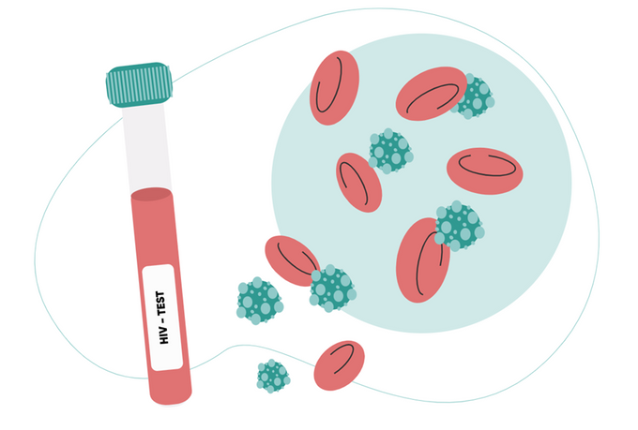
Use of any PrEP product would be contraindicated in clients with: HIV (including inconclusive HIV status)
Clients with reactive HIV test(s) should have the diagnosis confirmed and be referred for initiation of HIV antiretroviral therapy (ART) in accordance with national guidelines. Do not start PrEP in clients with a confirmed HIV diagnosis or use PrEP and ART together.
Clients with inconclusive HIV test results should be re-tested for HIV according to national guidelines. PrEP eligibility screening should be deferred and alternative HIV prevention strategies suggested in the interim.

Slide 52

Use of any PrEP product would be contraindicated in clients with: High indication for PEP based upon possible HIV exposure past 72 hours
For those in whom PEP is indicated, a 1-month course of PEP should be started without delay. WHO recommends, as the preferred regimen, a 3-drug PEP regimen containing tenofovir disoproxil fumarate (TDF) and either lamivudine (3TC) or emtricitabine (FTC) as the backbone with dolutegravir (DTG) as the third drug, though a 2-drug regimen is effective. The PEP regimen used should be in accordance with national PEP guidelines in your country. PEP and PrEP should not be used at the same time. After completing PEP, clients may then immediately start PrEP, following a negative HIV test and if clinically eligible for the PrEP product.

Slide 53

Use of any PrEP product would be contraindicated in clients with: Allergic reaction to the medicine(s) in PrEP
Do not start a PrEP product if a client has previously had an allergic reaction to the medicine(s) in that product. An alternative PrEP product may be suitable.
Note: Country-specific regulatory approvals and policies may specify minimum weight and/or age requirements for use; providers should always follow their national guidelines.

Slide 54
We’ll now review the contraindications specific to LEN. When a contraindication exists, clinical management options and alternatives are suggested.

Slide 55
LEN Contraindications & Considerations
L
In addition to the contraindications listed above for all PrEP products (positive or inconclusive HIV status, high indication for PEP, allergy to PrEP medication), the following contraindications and considerations to starting LEN also apply:
HIGH SUSPICION OF ACUTE HIV INFECTION
USE OF MEDICATIONS THAT INTERACT WITH LEN, WITH CONTRAINDICATIONS AND CONSIDERATIONS VARYING BY PRODUCT
RELEVANT COMORBIDITIES: NONE KNOWN

Slide 56
LEN Contraindications & Considerations
L
HIGH SUSPICION OF ACUTE HIV INFECTION
If you have a high suspicion of AHI after assessing signs/symptoms and exposure history, advise the client to return in 1 month for HIV retesting. Further assessment of LEN eligibility should be deferred. The potential risks and benefits of deferring vs. starting LEN should be made on a case-by-case basis, with deferral chosen only when the risks of potentially starting LEN during AHI are deemed to outweigh the benefits of using it to prevent HIV.
Alternative HIV prevention strategies should be chosen while awaiting HIV retesting, which may include use of DVR, if available.
Reminder: Use of LEN by individuals living with HIV can result in development of viral drug resistance, whereby use of LEN or other capsid inhibitor drugs may be less effective at treating HIV in the future.

Slide 57
LEN Contraindications & Considerations
L
USE OF MEDICATIONS THAT INTERACT WITH LEN, WITH CONTRAINDICATIONS AND CONSIDERATIONS VARYING BY PRODUCT
There are no contraindications to using LEN due to use of other medications.
Use of any of the following medications concomitantly with LEN or in the months after LEN discontinuation may require a dose adjustment (to the dose of either LEN or the other medication). Prescribers should review the regulatory labels of both medications when being prescribed for concomitant use or when the other medication is used after LEN has been discontinued:
Rifabutin
Rifampicin
Rifapentine
Carbamazepine
Phenobarbital
Phenytoin
Ketamine
Avanafil
Sildenafil
Tadalafil
Vardenafil
LEN is not expected to interact with gender-affirming hormones based upon the limited evidence available.

Slide 58
LEN Contraindications & Considerations
L
RELEVANT COMORBIDITIES: NONE KNOWN
There are no known comorbid conditions that contraindicate LEN use; therefore, no assessments of comorbidities are routinely necessary. It should be noted that individuals with severe hepatic impairment did not participate in LEN clinical trials.

Slide 59
Summary of Key Points in Lesson 2
To determine whether a client is clinically eligible to start PrEP, providers should assess the following:
HIV Testing
Possible exposure to HIV in the past 72 hours (“PEP Assessment”)
Signs/symptoms of acute HIV infection in past 2 weeks in the context of possible HIV exposure(s) in past 1 month ("AHI Assessment")
Use of other medications or products that may interact with PrEP
Medication allergies/hypersensitivities
Comorbidities

Slide 60
Summary of Key Points in Lesson 2
To rule out HIV infection before starting PrEP, HIV testing alone is not sufficient. After testing clients for HIV, providers must also assess whether PEP is indicated (based on possible exposure to HIV past 72 hours), and assess whether there is a suspicion of AHI (based on signs/symptoms and exposure history).
These 3 steps should be completed in this order:
HIV Testing
Possible exposure to HIV in the past 72 hours (“PEP Assessment”)
Signs/symptoms of acute HIV infection in past 2 weeks in the context of possible HIV exposure(s) in past 1 month ("AHI Assessment")

Slide 61
Summary of Key Points in Lesson 2
Identifying early/pre-existing HIV infection among clients seeking PrEP is important, since inadvertently starting PrEP in individuals living with HIV may have negative clinical consequences, including:
1) delayed start of ART
2) delayed detection of HIV by HIV tests (depending on the PrEP product started)
3) risk of developing viral drug resistance (depending on the PrEP product started)
For HIV testing, providers should use the diagnostic tests specified in each country’s national HIV testing algorithm and ideally conduct testing on the day the client intends to start PrEP. WHO recommends rapid diagnostic tests for initiation, continuation and reinitiation of any PrEP product, including long-acting injectable products.
PEP may be indicated instead of starting PrEP if the client reports a possible exposure to HIV in the prior 72 hours. The indication for PEP is higher in clients with higher-risk exposures (based on factors such as condom use, type of sex, HIV status of partner(s), and partner type), and PEP is more likely to be effective when started as soon as possible after exposure (ideally within 24 hours and always within 72 hours).

Slide 62
Summary of Key Points in Lesson 2
Providers should assess for a suspicion of AHI based on AHI-like signs/symptoms and HIV exposure history, in case further PrEP eligibility determination should be deferred pending HIV retesting in 28 days. Suspicion of AHI would be higher in clients with AHI signs/symptoms in the past 2 weeks and higher-risk exposure(s) in the past 1 month (based on factors such as condom use, type of sex, HIV status of partner(s), partner type).
WHO does not consider pregnancy or breastfeeding a contraindication to use of any of the recommended PrEP products, though pregnancy testing may be desired by some individuals for decision making purposes. There are less data on safety in pregnancy and breastfeeding for DVR, CAB-LA and LEN compared to TDF-based oral PrEP.
Clients seeking PrEP may also benefit from services to address other health and social needs (as appropriate), such as: STIs; SRH; hepatitis B and C; mental health; drug and alcohol use; gender-affirming care; and, GBV/IPV support and referral.
Assessing for comorbidities and comorbidity-related contraindications varies by PrEP product. If comorbidities preclude use of the preferred product, an alternative PrEP product may be offered as a suitable option instead (unless the contraindication applies to multiple/all products).

Slide 63
Summary of Key Points in Lesson 2
LEN
Contraindications
HIV-positive or inconclusive test results
High indication for PEP
High suspicion of AHI
There are no medications that are contraindicated with LEN.
Previous allergic reaction to lenacapavir use
Considerations
Use of any of the following medications concomitantly with LEN or in the months after LEN discontinuation may require a dose adjustment (to the dose of either LEN or the other medication). Prescribers should review the regulatory labels of both medications when being prescribed for concomitant use or when the other medication is used after LEN has been discontinued:
Rifabutin
Rifampicin
Rifapentine
Carbamazepine
Phenobarbital
Phenytoin
Ketamine
Avanafil
Sildenafil
Tadalafil
Vardenafil

Slide 64
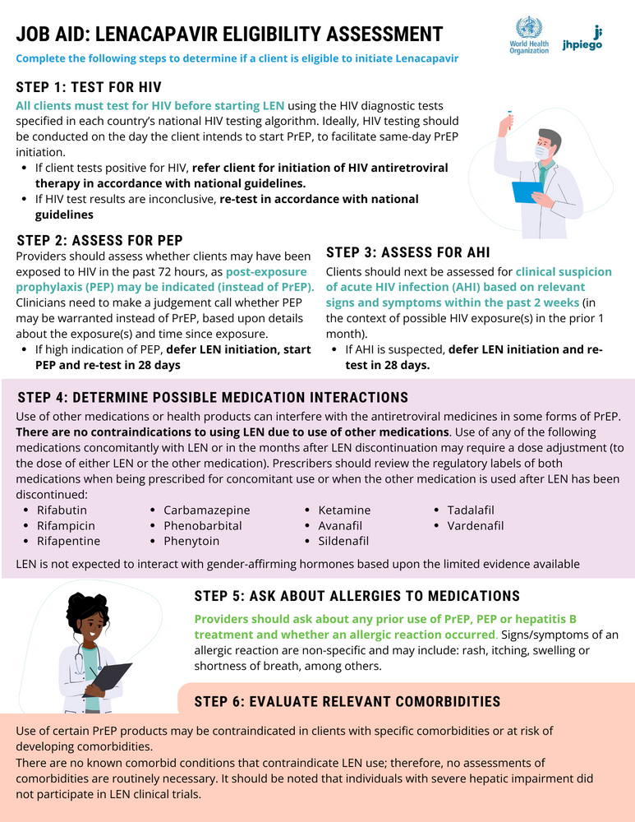
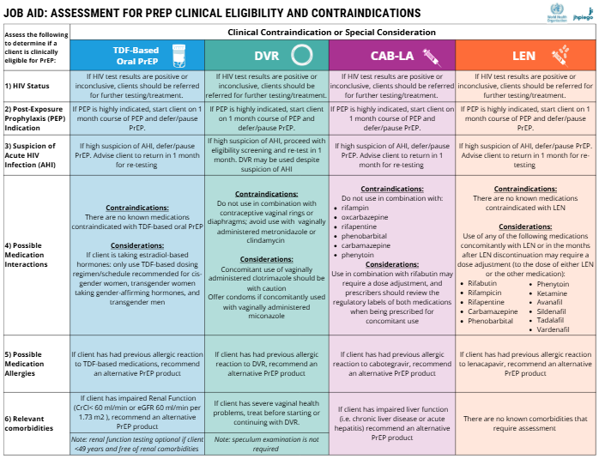
Downloadable Resources for Lesson 2:
The information presented in this lesson on assessing clinical eligibility is summarized in the resource titled: Job Aid: Assessment for PrEP Clinical Eligibility and Contraindications and Job Aid: Lenacapavir Eligibility Assessment which are available for download

Slide 65
Provider Training Toolkit on Use of Oral and Long-acting HIV Pre-Exposure Prophylaxis (PrEP)
LESSON 3: LEN ADMINISTRATION AND DOSING

Slide 66
LEARNING OBJECTIVES
Upon completion of Lesson 3, you should be able to:
Describe how LEN is administered or used
Identify how often clients need to return for a new supply of LEN
Define the dosing frequency for routine use of LEN
Describe the starting dose(s) and time it takes to be protected from HIV for LEN
Define how long a client remains protected after the last dose of LEN
Describe how long LEN remains in the body after the last dose and clinical management after stopping LEN
Define how to transition from using one PrEP product to another in a way that ensures uninterrupted HIV protection
Describe dosing irregularities and how to manage these clinically

Slide 67
Lenacapavir (LEN) Administration
L

Slide 68
LEN Administration
L
LEN is manufactured as an oral pill and as a liquid solution for injection. Dosing to start LEN must always include both injections and pills, followed by injections every six months thereafter to continue routine LEN use. Deviations from the dosing schedule should be avoided.
Instructions for administering subcutaneous LEN injections are divided into the following sections:
Preparing the LEN solution for injection using the appropriate medical supplies and techniques
Injecting LEN subcutaneously by identifying the injection location and using an appropriate injection technique

Slide 69
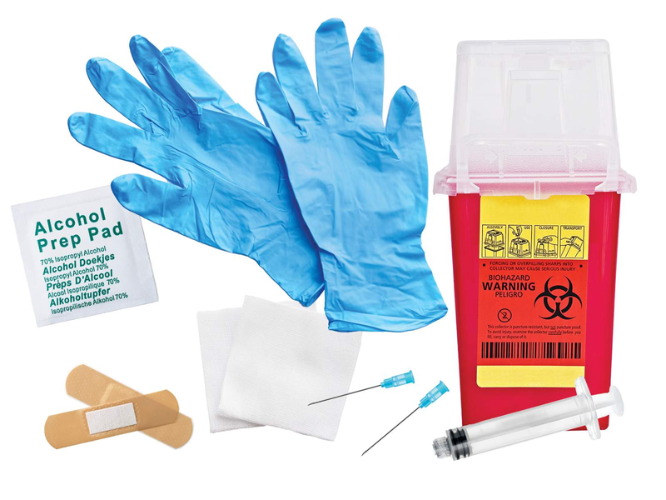
LEN Administration
L
Step 1: Prepare Supplies Needed for injection
The following supplies are needed for each LEN injection:
Syringe (at least 3ml)
18g 1½ inch needle for withdrawing solution from the vial into the syringe (“withdrawal needle”)
22g ½ inch needle for injection (“injection needle”)
Non-sterile gloves
Alcohol wipes
Gauze pads
Sharps container
Adhesive bandage (in case of bleeding)

Slide 70
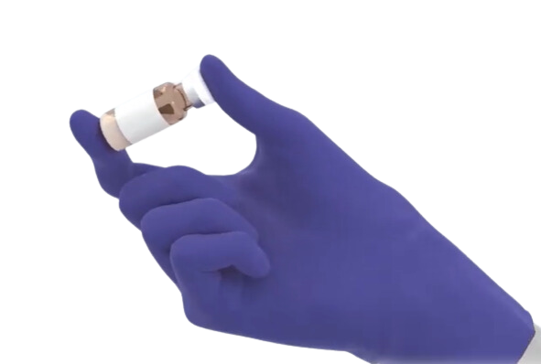
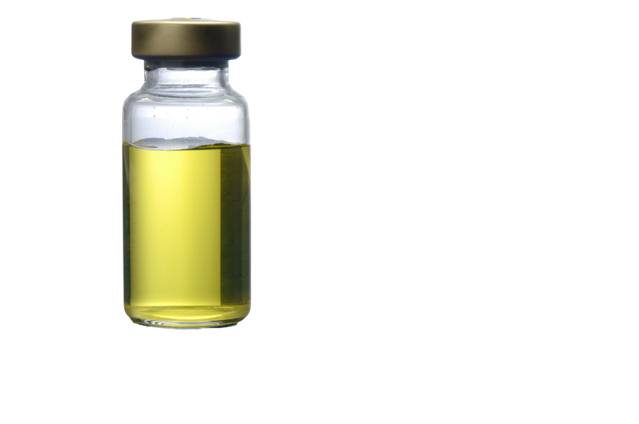
LEN Administration
L
Step 2: Preparing Solution for Injection
Inspect the vial to ensure the solution is a yellow color, free from particles and the expiry date has not passed.

Slide 71
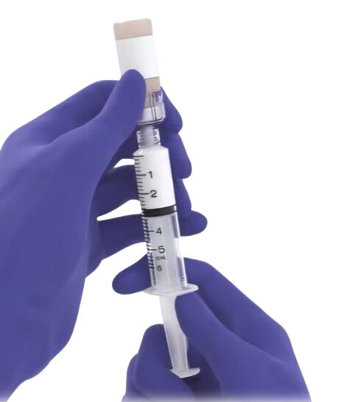

LEN Administration
L
Step 3: Preparing Solution for Injection
Remove vial cap and wipe top of uncapped vial clean with alcohol wipe. Using the syringe with withdrawal needle, inject 1.5 ml of air into the vial before withdrawing all contents from the vial.

Slide 72
LEN Administration
L
Step 4: Preparing Solution for Injection
Exchange the withdrawal needle to the new injection needle prior to injection.

Slide 73
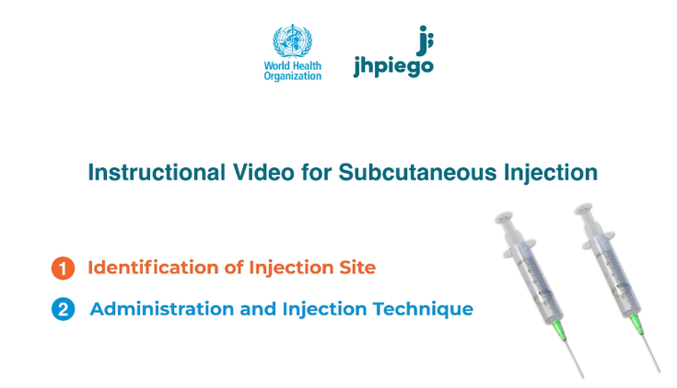
LEN Administration
L
Now that you’ve reviewed the supplies needed and steps for preparing the solution for injection, it’s time to determine the injection location and administer the LEN injection.
The animated video below depicts the injection procedures to be used to administer LEN.
LINK TO VIDEO

Slide 74

Now that you've watched the video, let’s review the steps on the procedures for identifying the injection location and injecting LEN.

Slide 75

Identifying Injection Site
L
LEN should be injected subcutaneously in either the abdominal or thigh area. If the abdominal area is chosen, the injections should be within 5 cm (2 inches) of the navel.
2 separate injections (of 1.5ml each) are required and should be administered in different locations, with the second location being at least 10 cm (4 inches) from the first.

Slide 76
Identifying Injection Site
L
Providers should choose the location in consultation with the client so that the client’s preferences are considered. The injection location chosen should also allow for pinching enough skin to properly inject the solution subcutaneously. Since injecting in the dermis layer of the skin must be avoided, the area with more body fat (and skin to pinch) may be preferrable. For instance, if the abdomen has more fatty tissue that can be pinched than the thigh, the abdominal area may be a more ideal choice.
The following injection steps should be completed once the injection site has been determined. As with other types of injections, clean the target area for injection by wiping with an alcohol wipe, using appropriate aseptic technique.

Slide 77

LEN Administration
L
Step 1: Injection Technique
Gently pinch a broad portion of skin at the injection site, as pinching may give more subcutaneous tissue to target for the injection (especially in clients with less subcutaneous tissue).
As noted earlier, it’s important the LEN solution is injected and forms a depot in subcutaneous tissue, not in the dermis of the skin. The pinching of skin should be gentle to avoid injecting into compressed tissue.

Slide 78
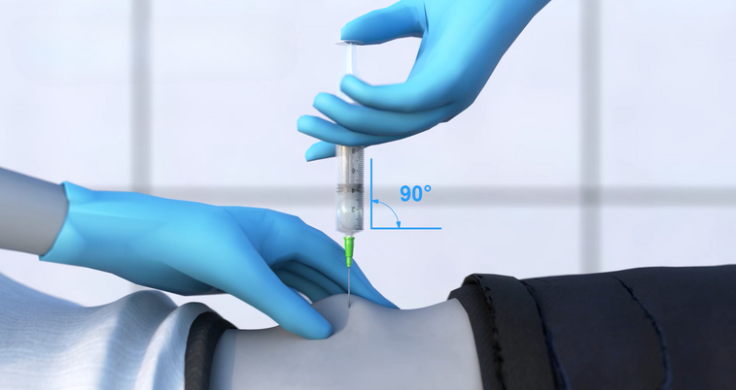
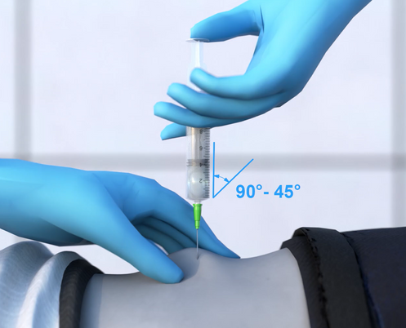
LEN Administration
L
Step 2: Injection Technique
At the apex of pinched skin, insert the needle fully. It is preferable for the needle to be inserted perpendicular (at a 90° angle) to the skin, in clients with adequate subcutaneous tissue.
For clients with minimal subcutaneous tissue, the needle may be inserted at an angle between 45°-90°. The needle should not be inserted at an angle less than 45°.

Slide 79
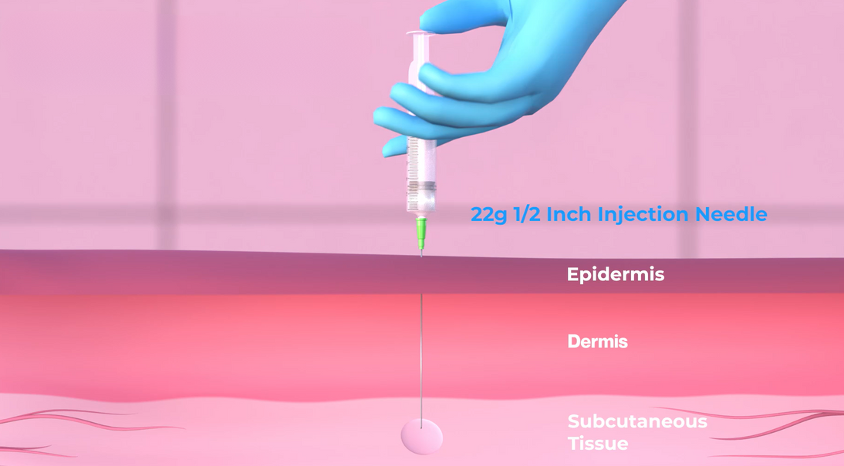
LEN Administration
L
Step 3: Injection Technique
LEN is a viscous solution, so slowly push the plunger to carefully perform the injection, which will create a medication depot of LEN in the subcutaneous tissue. Pause for several seconds after injecting before withdrawing the needle to ensure the full dose has been administered. Remove the needle from the skin at the same angle it was inserted.

Slide 80
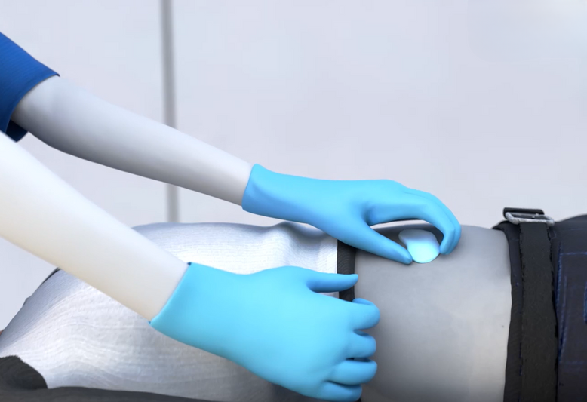
LEN Administration
L
Step 4: Injection Technique
Apply dry gauze at the injection site and then replace it with a bandage.

Slide 81
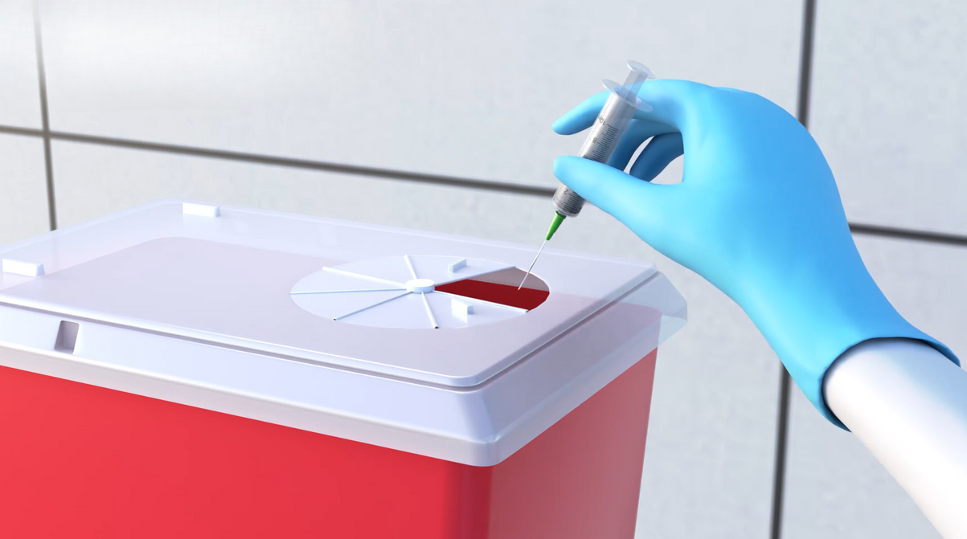
LEN Administration
L
Step 5: Post-Injection Disposal
After injection, dispose of the syringe and needles into the sharps container.

Slide 82

LEN Administration
L
Repeat these steps for the second injection.
Remember, the second injection location must be at least 4 inches from the first, and if in the abdominal area, at least 2 inches from the navel

Slide 83
Starting LEN and Time to Protection Onset

Slide 84

How is LEN started and how long does it take for protection to begin?
Different PrEP products are dosed, used or administered in specific ways initially to start.
None of the PrEP products provides immediate protection against HIV. Each must be used for a certain duration first, which varies by PrEP product. In the period before protection begins, clients should use alternative HIV prevention strategies.

Slide 85
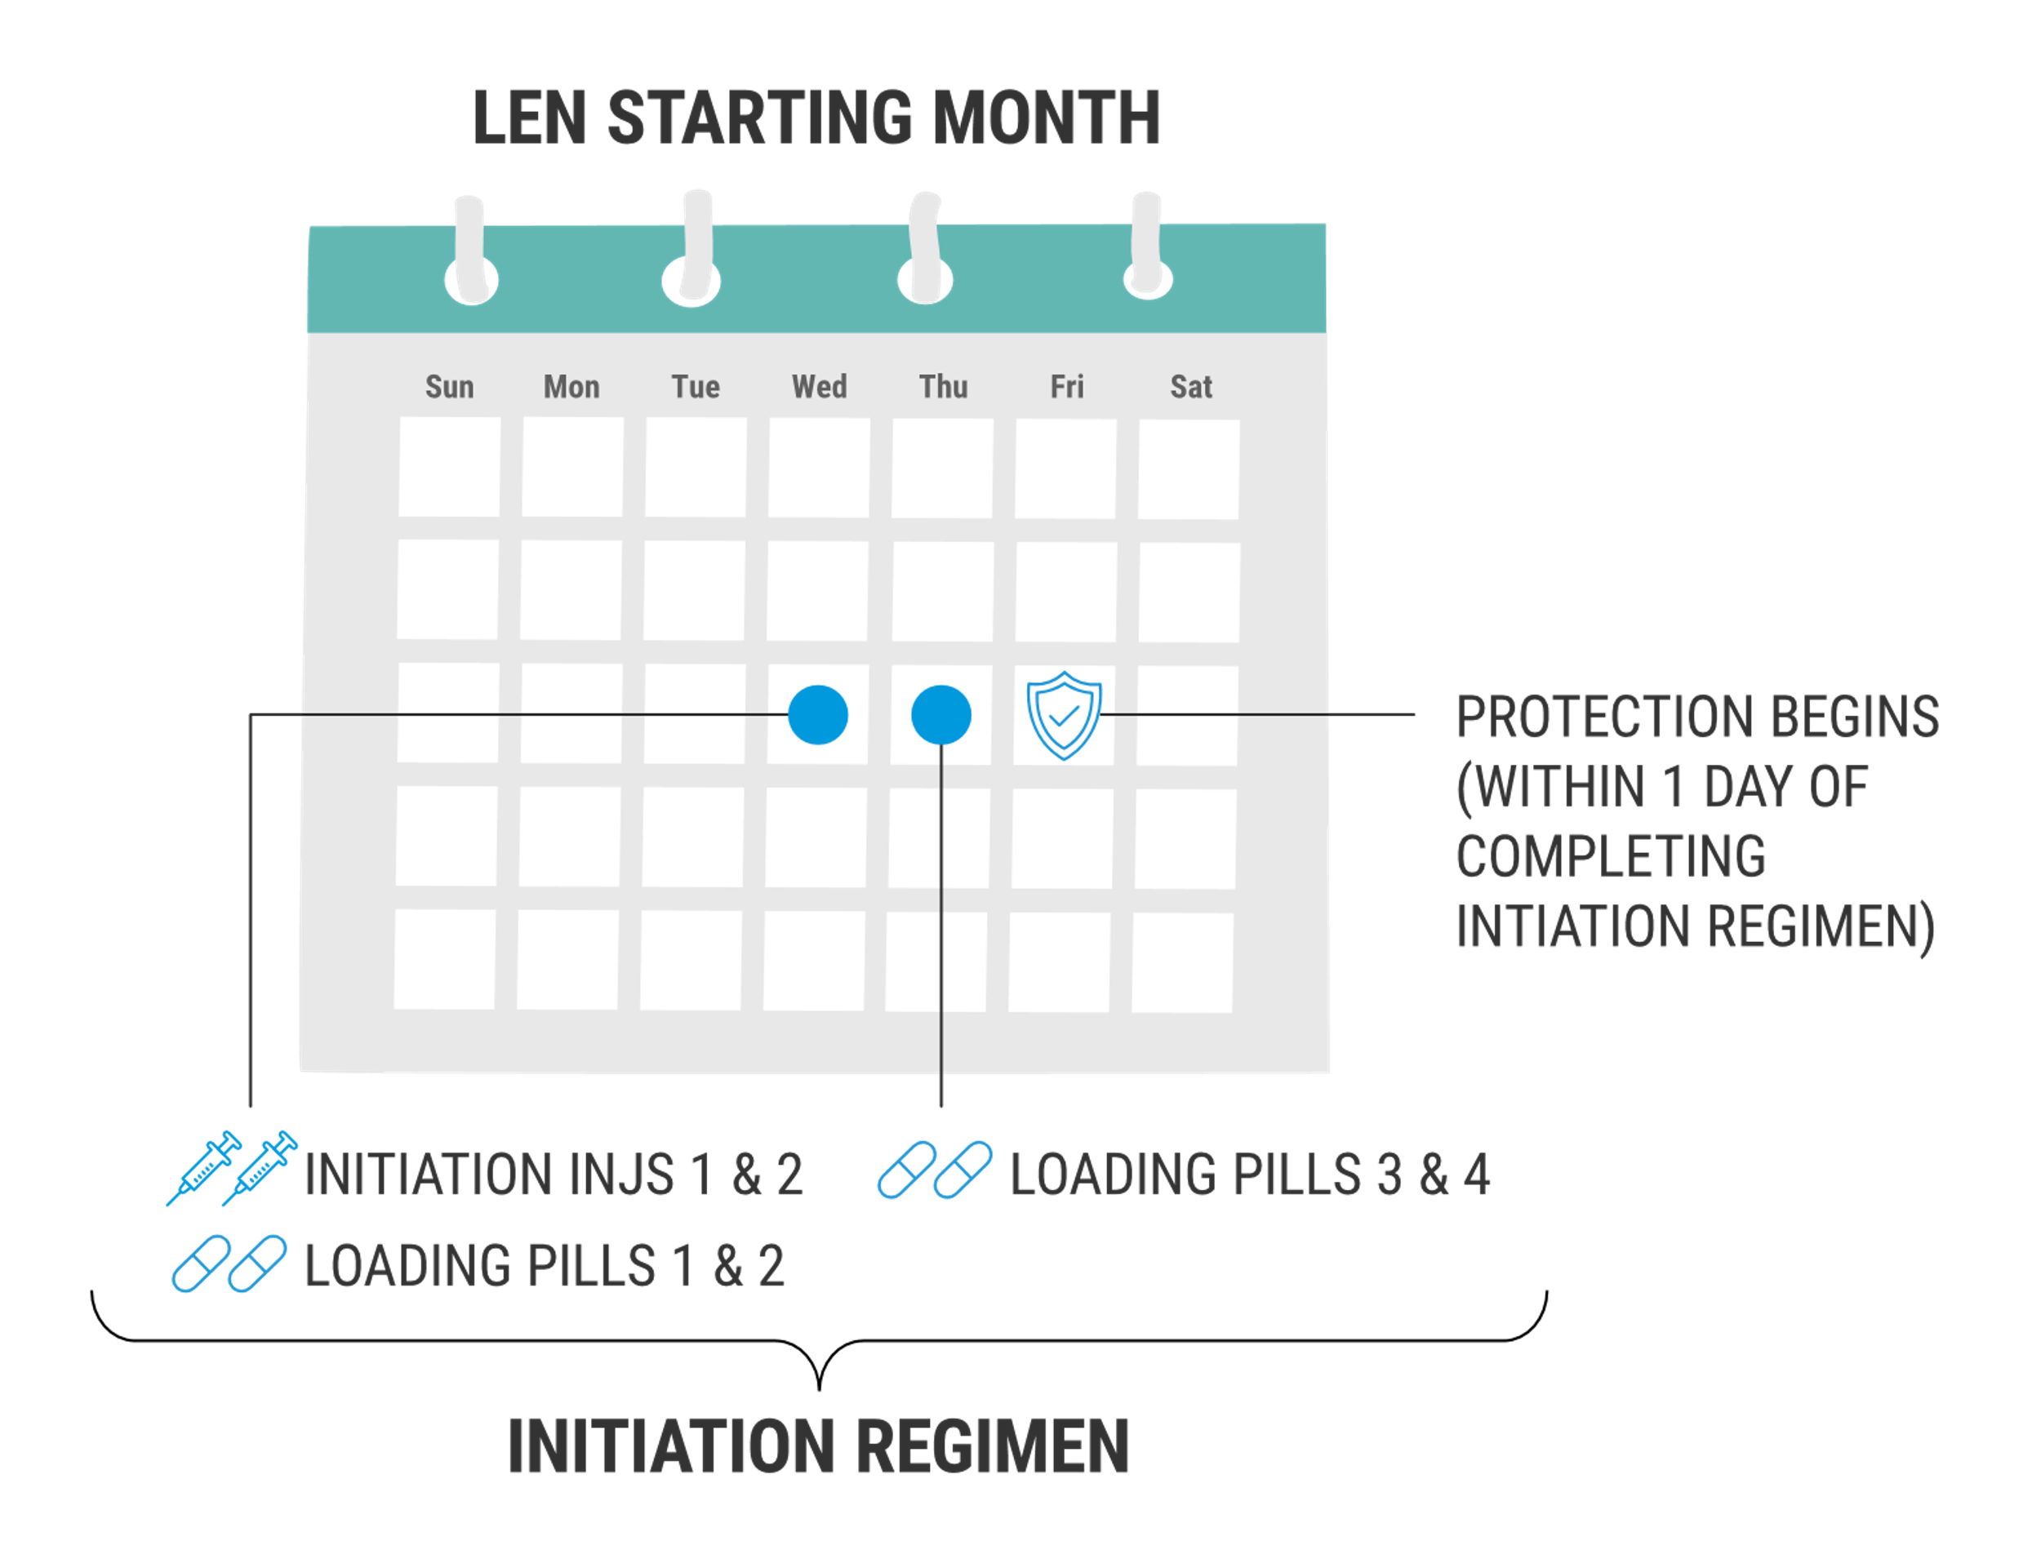
Starting LEN
L
Starting LEN requires multiple doses of both oral and injectable LEN which we refer to collectively as the “INITIATION REGIMEN.” The INTIATION REGIMEN of oral pills and injections must be administered for LEN to reach adequate drug levels in a timely manner. The INITIATION REGIMEN is completed over two consecutive days, as follows:
To start LEN:
Day 0
Provider administers two LEN injections (INITIATION INJECTION 1 & INITIATION INJECTION 2) in separate locations
Client takes 2 LEN pills (LOADING PILLS 1 & 2) by mouth, and is provided with LOADING PILLS 3 & 4 to carry home with them to use the following day (Day 1)
Day 1
Client takes 2 LEN pills (LOADING PILLS 3 & 4) by mouth

Slide 86
Starting LEN
L
Protection begins within 1 day of completing INITIATION INJECTIONS 1 & 2 and Loading Pills 1 & 2 (Day 0) in the INITIATION REGIMEN. Loading Pills 3 & 4 (Day 1) are important for ensuring sustained protection.
There should be no deviations from the INITIATION REGIMEN dosing specifications. Deviations may result in suboptimal protection against HIV, such as delays to onset of protection.

Slide 87
Continuing Use of LEN After Starting

Slide 88

Once PrEP has been started, what does ongoing PrEP use look like?
Now that we’ve examined details about initial dosing/use and the time to onset of protection for LEN, we’ll next describe how a client should continue use if sustained protection is needed.

Slide 89
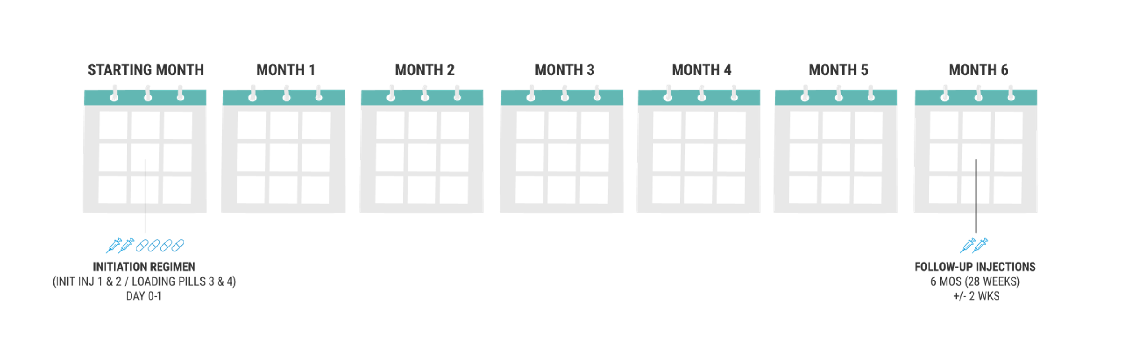
Continuing LEN
L
After starting LEN by the INITIATON REGIMEN (INITIATION INJECTIONS 1 & 2 and Loading Pills 1 & 2 – Day 0; Loading Pills 3 & 4 – Day 1), subsequent LEN injections are necessary every six months (26 weeks) for those wanting to sustain protection. We refer to these bi-annual injections as FOLLOW-UP INJECTIONS.
There is a +/- 14 day scheduling window for all FOLLOW-UP INJECTIONS.
INITIATION REGIMEN
(INITIATION INJECTIONS 1&2/ LOADING PILLS 1-4)
FOLLOW-UP INJECTIONS
6 MONTHS (26 WEEKS) +/- 14 DAYS

Slide 90
Final Dosing and Discontinuation of PrEP

Slide 91

How long does HIV protection last after the final dose? How long does LEN remain in the body after stopping and what are the clinical management considerations?
Here we’ll describe considerations around final dosing of LEN, as well as how long the medication remains in the body.
After discontinuing any PrEP product, if HIV exposure(s) resumes in the future, clients wishing to start using PrEP again should be supported to restart (or use a different PrEP product or HIV prevention strategy suited to their needs and preferences). There is no limit to the number of times a client may restart a PrEP product.

Slide 92
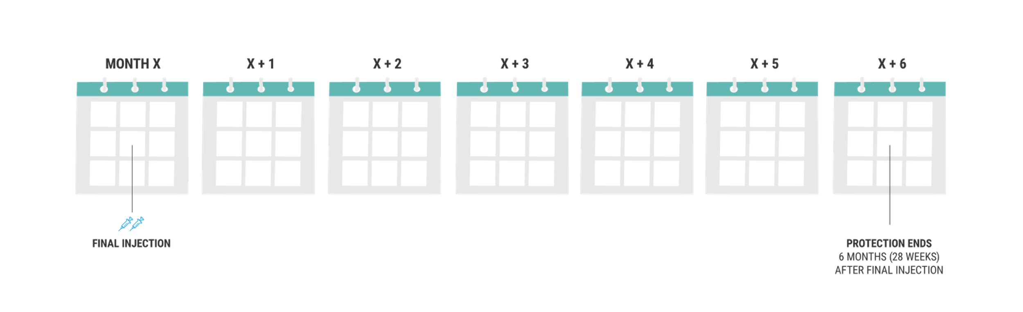
After Final Injection: LEN
L
LEN continues to provide protection for 6 months after the last injection, whether the last injection administered was an INITIATION INJECTION 2 or a FOLLOW-UP INJECTION. If for any reason a client only received INITIAITON INJECTION 1, protection against HIV is unknown.
After a LEN injection (regardless of injection type), lenacapavir remains in the body for approximately 1 year, often referred to as the “tail.” Drug levels are only protective for the ﬁrst 6 months of the tail phase. For the 6 remaining months of the tail, lenacapavir levels are too low to provide protection. Throughout this latter period of the tail, a client acquiring HIV may be at risk of negative clinical outcomes, including HIV drug resistance. Though not observed to date, diagnostic complications in such individuals may also be possible.
FINAL INJECTION
PROTECTION ENDS
6 MONTHS (26 WEEKS) +/- 14 DAYS AFTER FINAL INJECTION

Slide 93

Additional Details: Delayed Detection of HIV after LEN Discontinuation
It is not known whether clients who discontinue LEN and subsequently acquire HIV at any point in the year-long tail phase may experience an interference in the production of anti-HIV antibodies and delays the ability of HIV tests to detect HIV.

Slide 94
Additional Details: Viral Drug Resistance after LEN Discontinuation
Clients who have discontinued LEN and subsequently acquire HIV in the year-long tail phase, may be at risk of developing viral drug resistance. Though no data exist at present, it’s possible LEN resistance could render LEN or other future capsid inhibitor medications less effective at treating HIV. However, capsid inhibitors are not currently routinely used in HIV treatment regimens, so the implications of LEN drug resistance to clinical care should be minimal.

Slide 95
Transitioning Between PrEP Products

Slide 96

What special considerations should be made for clients wishing to transition from using one PrEP product to another?
Clients starting a particular PrEP product may decide later to switch to another option, for any number of reasons that may be related to their preferences or product characteristics.
Here we present a number of considerations to help providers manage switching between PrEP products and maintaining continuity of HIV protection through overlapped use.
For example, because the new PrEP product will not begin to protect against HIV immediately, it should be started before the prior PrEP product stops providing protection.

Slide 97
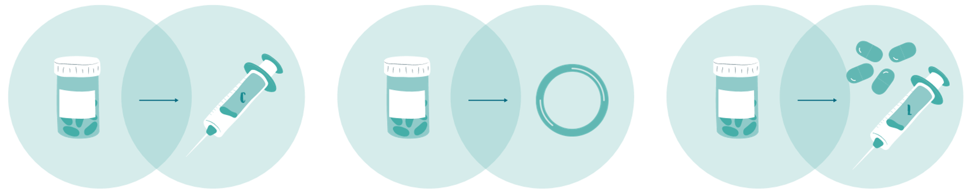
Switching from Oral PrEP
A client wishing to discontinue TDF-based oral PrEP and start LEN product may do so, if clinically eligible to use LEN. An eligibility assessment to detect contraindications would be needed, as described in Lesson 2.

Slide 98
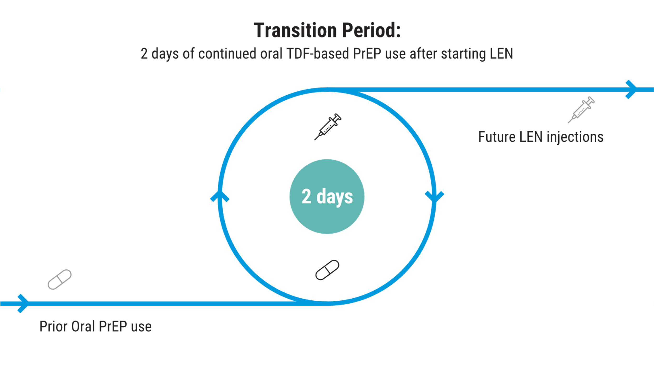
Switching from Oral PrEP - To LEN
Clients should continue using TDF-based oral PrEP throughout both days of receiving INITIATION REGIMEN to start LEN (all doses).

Slide 99
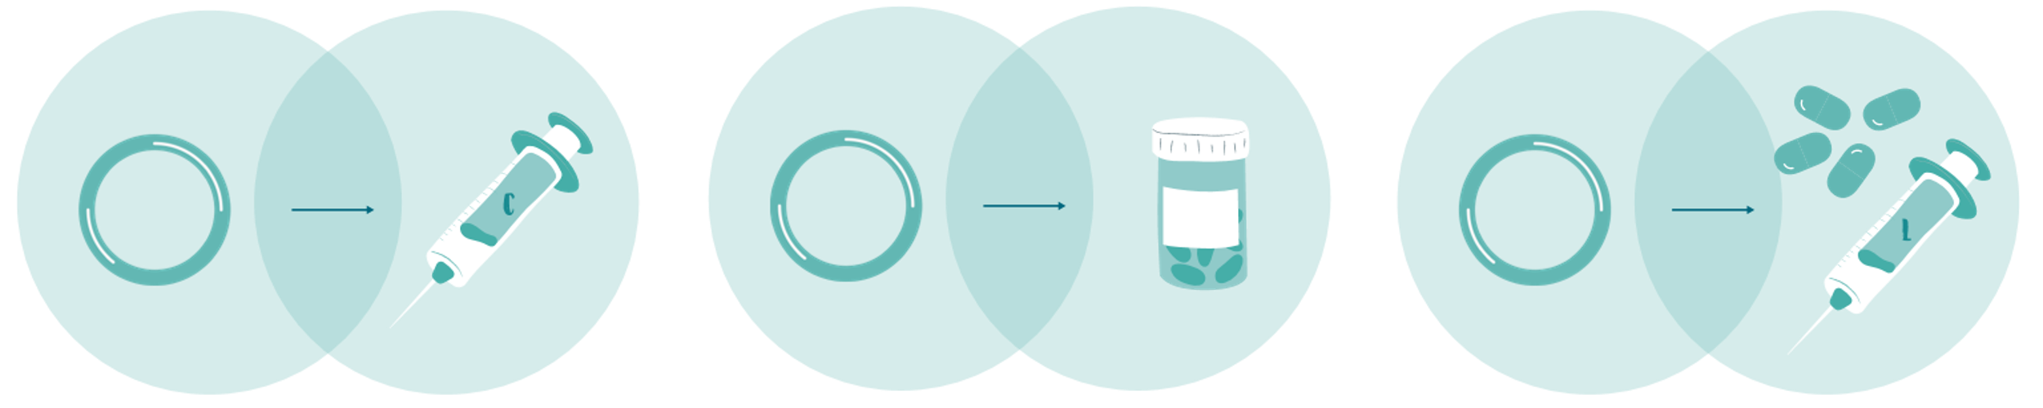
Switching from DVR
A client wishing to discontinue DVR and start LEN may do so, if clinically eligible to use LEN. An eligibility assessment to detect contraindications would be needed, as described in Lesson 2.

Slide 100
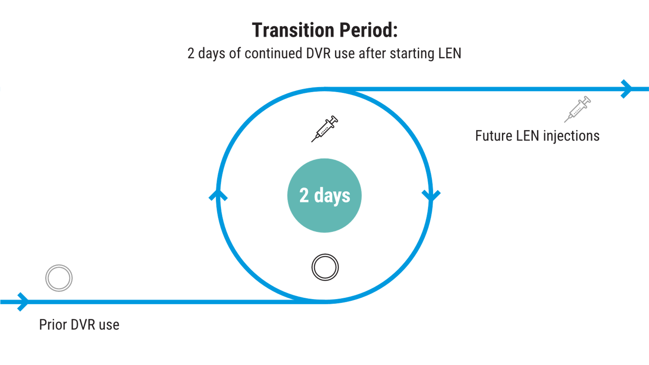
Switching from DVR - To LEN
Clients should continue wearing DVR throughout both days of receiving the INITIATION REGIMEN to start LEN (all doses).

Slide 101
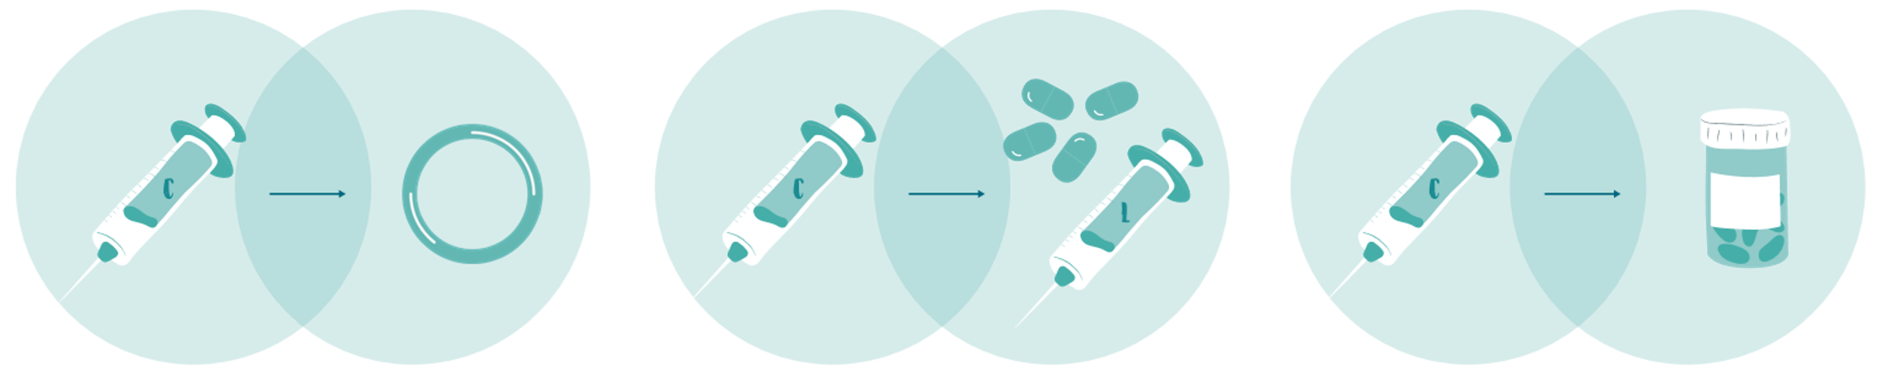
Switching From CAB-LA
A client wishing to discontinue CAB-LA and start LEN may do so, if clinically eligible to use LEN. An eligibility assessment to detect contraindications would be needed, as described in Lesson 2.

Slide 102
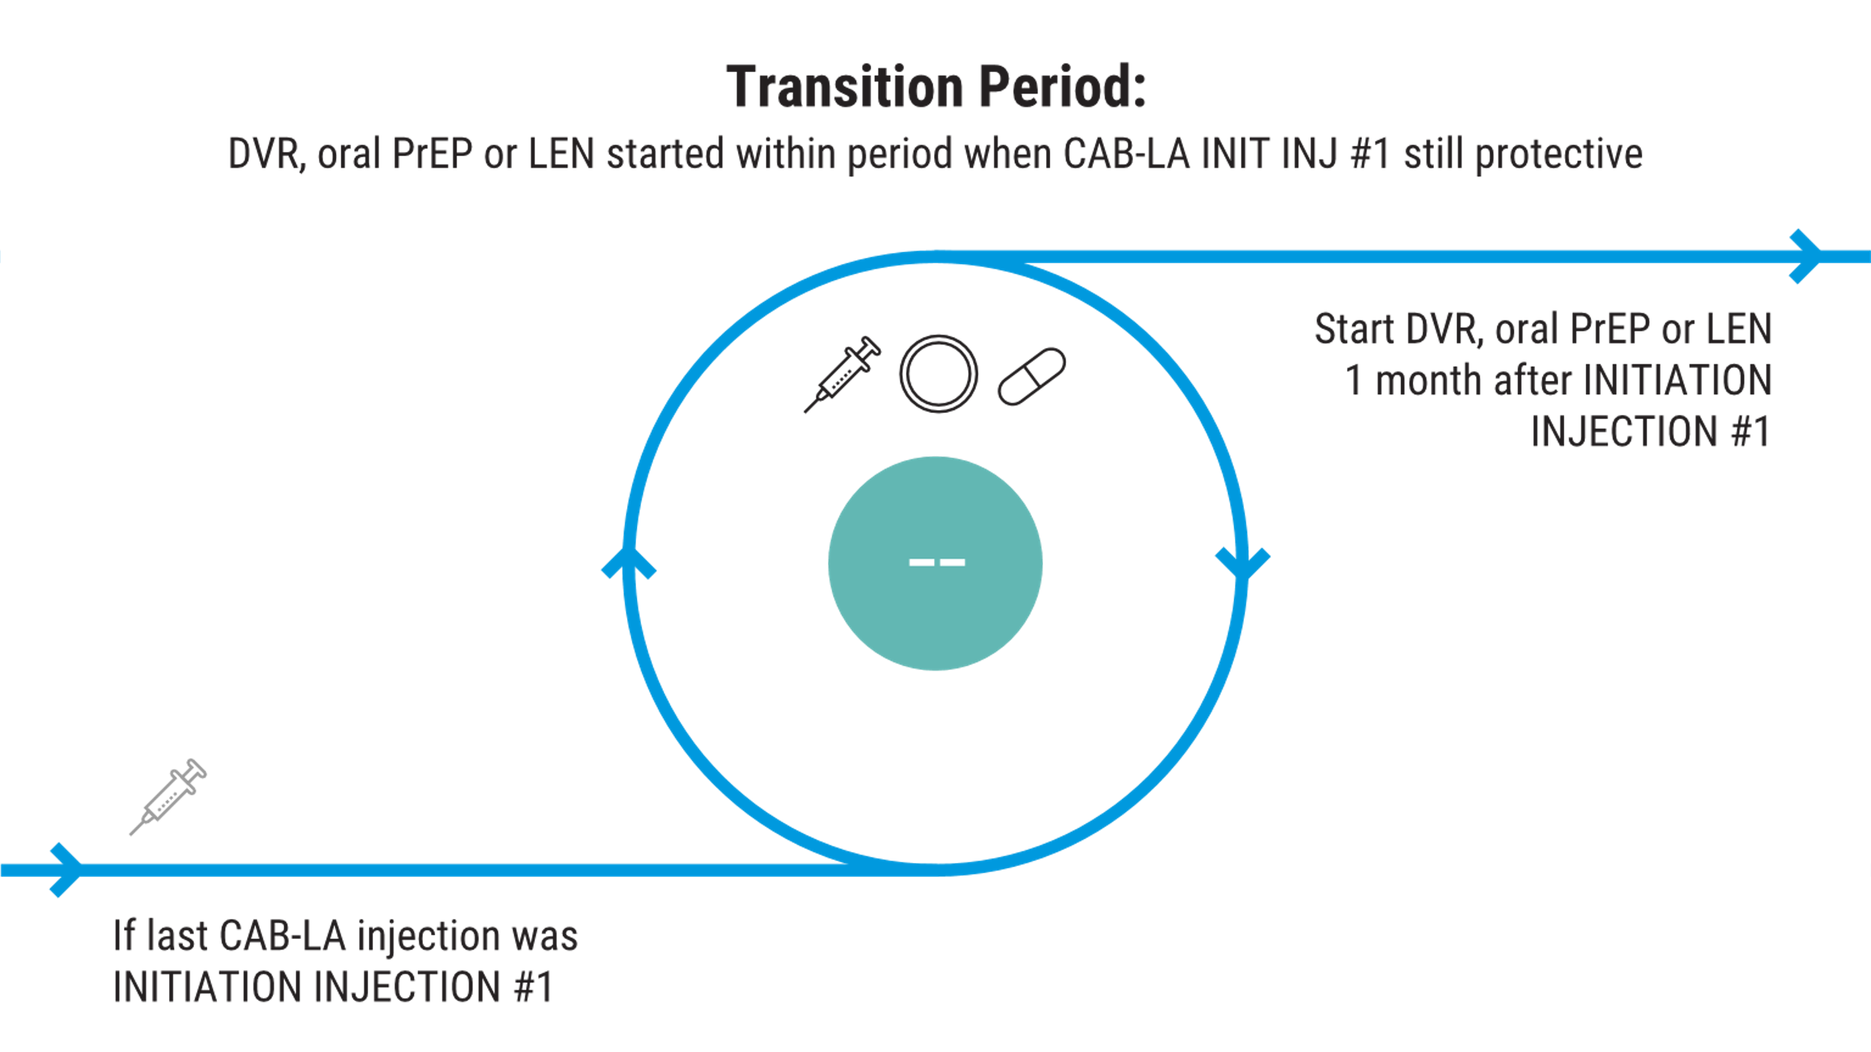
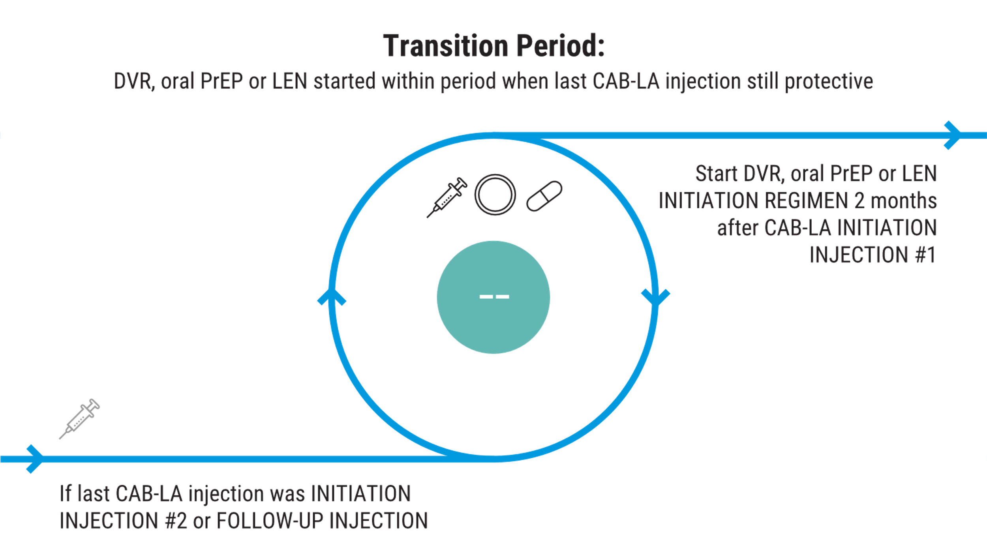
Switching From CAB-LA - To LEN
Clients should start the LEN INITIATION REGIMEN 2 months after INITIATION INJECTION 2 or FOLLOW-UP INJECTION to ensure continued coverage.
Clients should start the LEN INITIATION REGIMEN 1 month after INITIATION INJECTION 1 to ensure continued coverage.

Slide 103
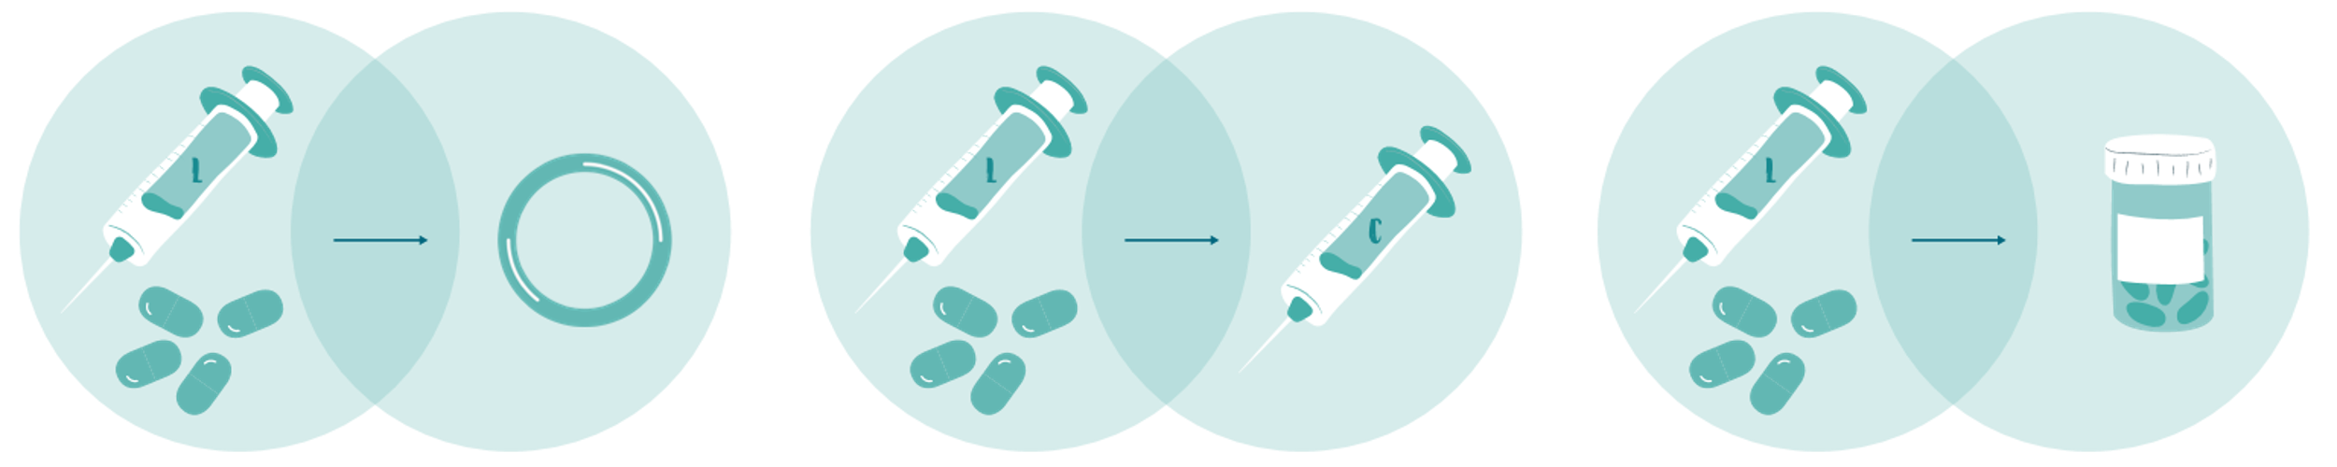
Switching From LEN
A client wishing to discontinue LEN and start another PrEP product may do so, if clinically eligible to use the new product. An eligibility assessment to detect contraindications would be needed, as described in Lesson 2.

Slide 104
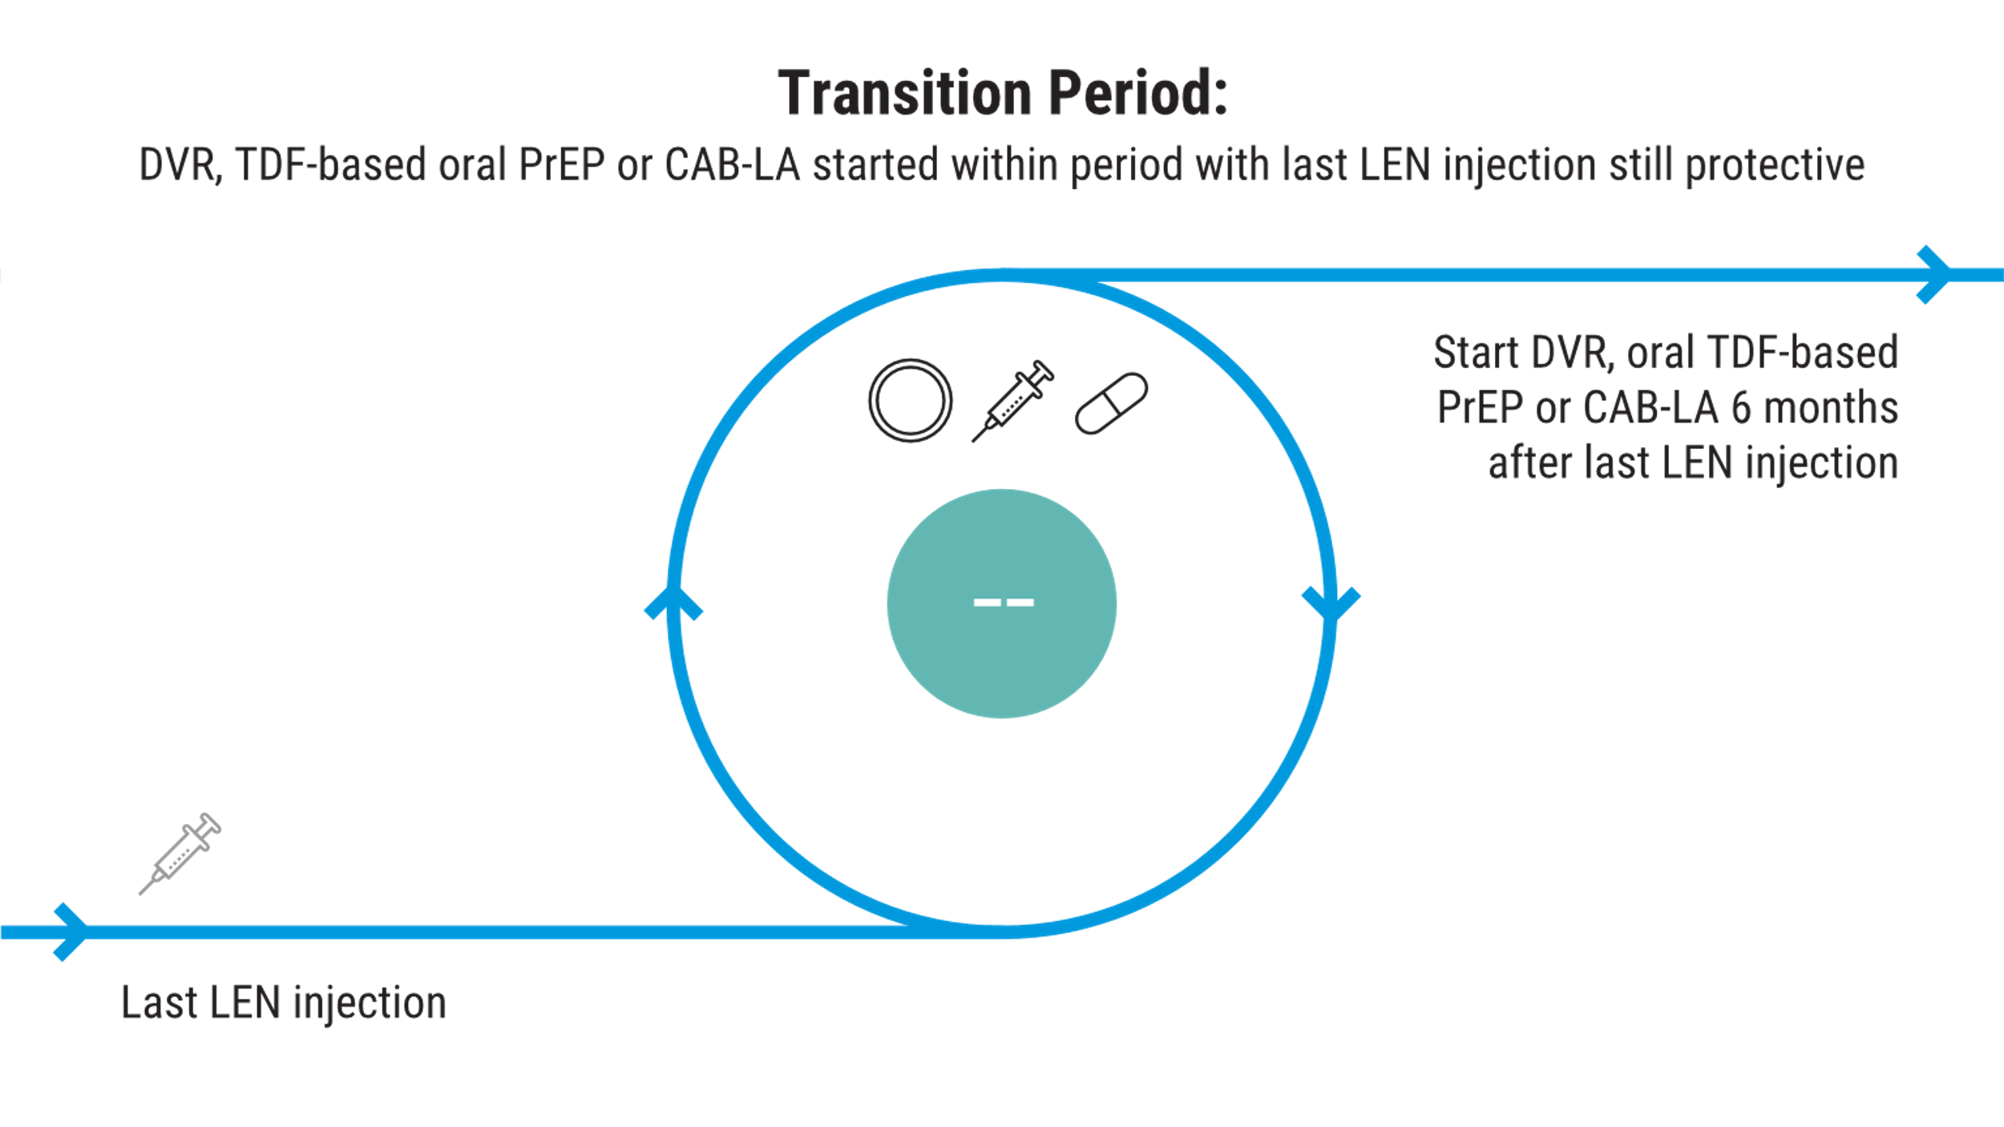
Switching From LEN - To DVR, CAB-LA, or Oral PrEP
Clients should insert the DVR, start CAB-LA or start TDF-based oral PrEP 6 months after the last LEN injection was administered, regardless of the type of LEN injection last administered, to ensure continued coverage.

Slide 105
Use Irregularities

Slide 106

How Are Missed Doses Managed?
Protection against HIV is highest when PrEP is used is as instructed. Not using the PrEP product correctly or as often as instructed may lower the level of protection against HIV.
If a client misses a dose of PrEP (or does not take it, is not using it, or returns late), the clinical management decisions depend upon the product they are using.

Slide 107
Missed Injections: LEN
L
If a client misses a scheduled injection and wants to continue LEN, they should return to the site as soon as they are able.
The provider needs to make a decision whether to restart LEN with the INITIATION REGIMEN (INITIATION INJECTIONS 1 & 2 and Loading Pills 1 & 2 – Day 0; Loading Pills 3 & 4 – Day 1) or resume by administering FOLLOW-UP INJECTIONS.

Slide 108
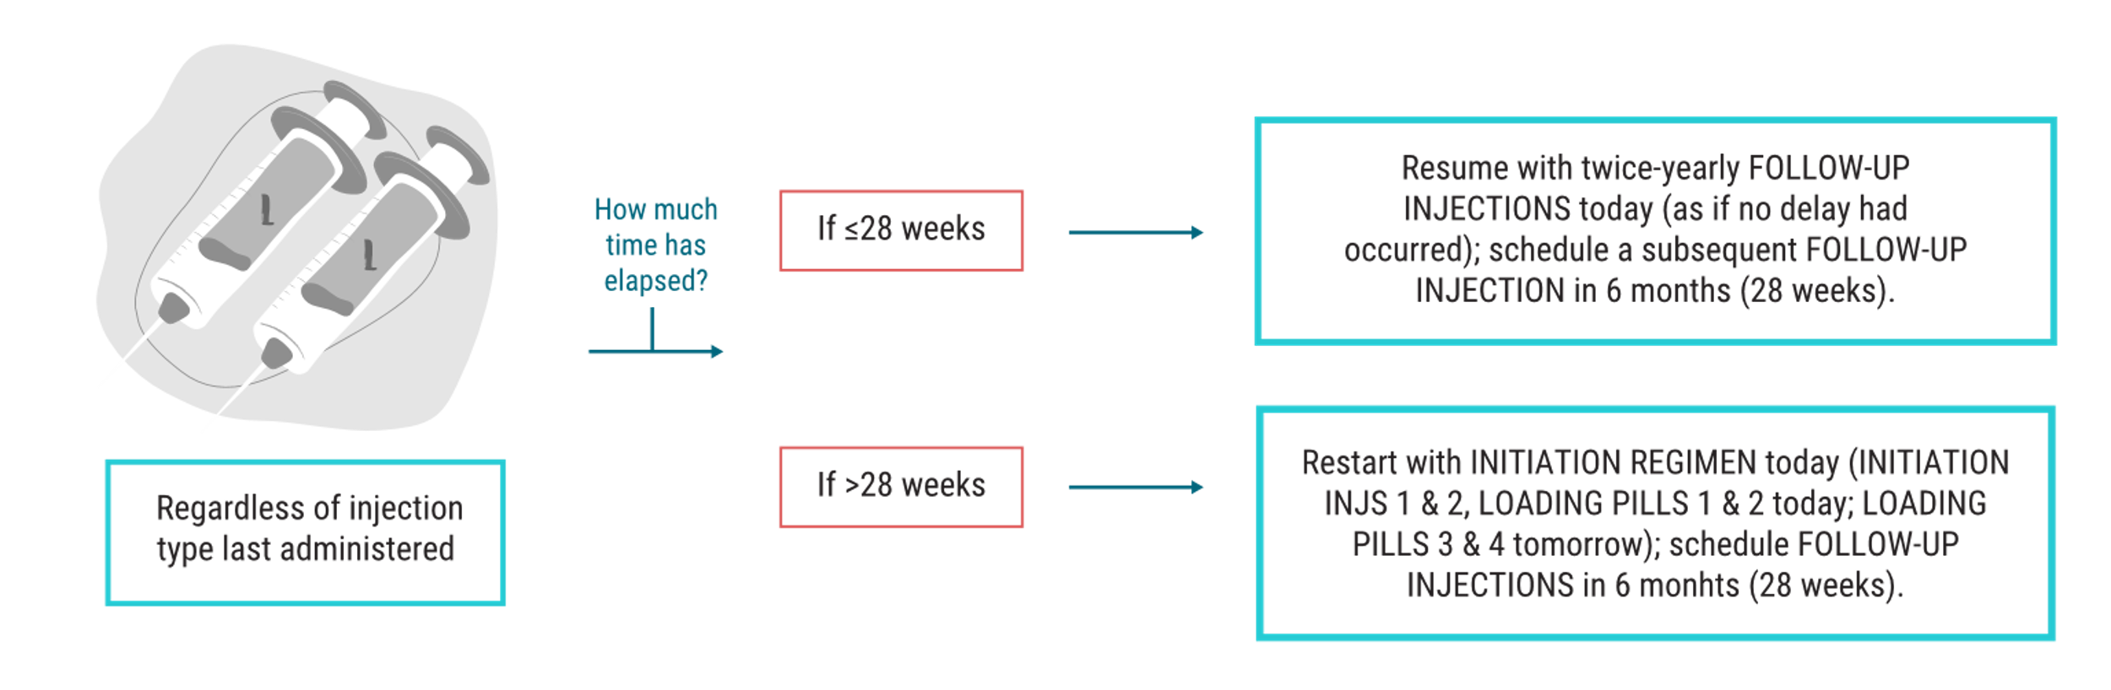
Missed Injections: LEN
L
The amount of time elapsed since their last injection will determine how to proceed, as follows:
If ≤ 28 weeks (6 months plus 2 weeks) elapsed since prior injection, resume with bi-annual Follow-up Injection today; schedule a subsequent Follow-Up Injection in 6 months
If > 28 weeks elapsed since prior injection, restart with all LEN Loading Doses over two days (Loading Injections 1 & 2 and Loading Pills 1 & 2).

Slide 109
Missed Injections: LEN
L
Before resuming or restarting LEN injections in a client delayed in returning, providers should re-test for HIV and clinically re-assess in case PEP is indicated or there is a suspicion of AHI. These topics will be covered in more detail in Lesson 4.

Slide 110
Additional Info About Postponing Future LEN Injections
In the prior section, we addressed the management of clients who return late after having already missed a LEN injection visit. What about clients who know in advance they need to postpone their next LEN injection?
Regulatory labels in many countries make an allowance for postponing LEN FOLLOW-UP INJECTIONS beyond the 14-day scheduling window through the use of oral LEN pills to “bridge” the gap.

Slide 111
Additional Info About Postponing Future LEN Injections
As an example, a client who knows in advance they cannot return for their next FOLLOW-UP INJECTIONS within 28 weeks (6 months + 2 weeks), may be given and start using oral LEN 6 months after today’s injection and continue using it daily until they’re available to return for the next LEN injections.
If the provider decides to postpone the next injections with a bridge of oral LEN, the client will receive the LEN injections today and a supply of oral LEN pills to take with them, with instructions to start using oral LEN pills 6 months from today by taking 1 pill each week. The period of oral LEN PrEP use is the “bridge.” The client would need to be given a suﬃcient supply of oral LEN pills for weekly use (1 pill per week) until their ﬁrst available date to return for LEN injections, so this duration would need to be calculated by the provider.

Slide 112
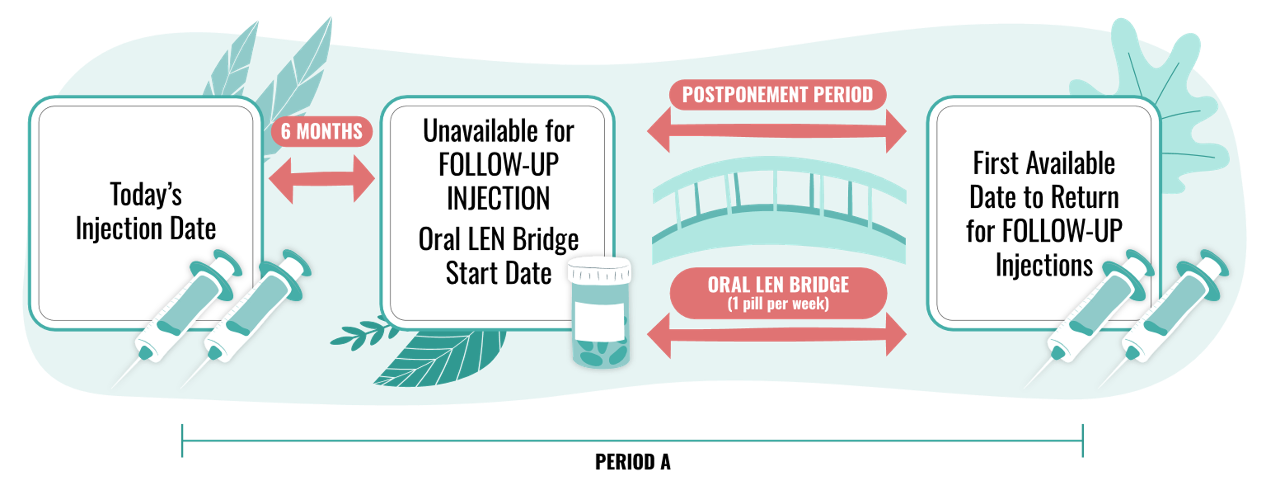
Additional Info About Postponing Future LEN Injections
Upon return to resume injections after the bridge, the provider should administer FOLLOW-UP INJECTIONS. It is not necessary to restart LEN with the INITIATION REGIMEN following a bridge with oral LEN, unless adherence to daily doses was poor.

Slide 113
Summary of Key Points in Lesson 3
None of the PrEP products provides immediate protection against HIV. Each must be used for a certain duration first, which varies by product, and alternative HIV prevention strategies should be used during the period before protection begins.
To sustain protection against HIV, repeated/continued PrEP use is necessary throughout periods of HIV exposure(s), regardless of the PrEP product.
All PrEP products provide greater protection against HIV when use of the product is as instructed; incorrect use, taking/using it late, or not taking/not using it may lower the level of protection.
Clients may transition immediately from using one PrEP product to another, as long as they are clinically eligible to do so; some overlap in use between products is often necessary to ensure protection is sustained during the transition.
Clients who discontinue a PrEP product but decide to use it again (or try another PrEP product), should be supported to restart PrEP as often as needed.

Slide 114
Summary: LEN
General Use:
LEN is manufactured as both an oral pill and a liquid solution for subcutaneous injection.
Injection Location/Technique:
LEN should be injected subcutaneously in either the abdominal or thigh area. Injections should be subcutaneous (not intradermal) and injected at an angle between 45-90°. The location for injections should allow for pinching enough skin to properly inject subcutaneously, and the area with more fatty tissue (abdominal or thigh) may be preferrable, noting client’s preferences about location should also be considered. Injections are administered 10 cm (4 inches) apart, and if in the abdomen, 5cm (2 inches) from the navel.
Starting LEN/Time to Protection:
Starting LEN requires receiving multiple LEN doses (oral pills and injections) in the INITIATION REGIMEN over two consecutive days, as follows:
Day 0: INITIATION INJECTIONS 1 & 2 (injected in separate locations) and LOADING PILLS 1 & 2
Day 1: LOADING PILLS 3 & 4
Protection begins within 1 day of completing INITIATION INJECTIONS 1 & 2 and Loading Pills 1 & 2 (Day 0) in the INITIATION REGIMEN. Loading Pills 3 & 4 (Day 1) are important for ensuring sustained protection.
Continuing LEN Use:
After starting LEN by administering the INITIATION REGIMEN (INITIATION INJECTIONS 1 & 2 and Loading Pills 1 & 2 – Day 0; Loading Pills 3 & 4 – Day 1), subsequent LEN injections (FOLLOW-UP INJECTIONS) are administered every six months (26 weeks). There is a +/- 14-day scheduling window for all FOLLOW-UP INJECTIONS.
Stopping LEN:
The duration of protection against HIV after the final injection is 6 months, regardless of the whether the last injections were INITIATION INJECTIONS 1 & 2 or FOLLOW-UP INJECTIONS. After the final injections, LEN remains in the body for approximately 1 year.. During the “tail” period (6-12 months after the last injection), lenacapavir levels are too low to provide protection. Throughout the tail, a client acquiring HIV may be at a theoretical risk of negative clinical outcomes, including HIV drug resistance. Though not observed to date, diagnostic complications in such individuals may also be possible. Quarterly follow-up visits starting 6 months after the last injection are thus recommended.

Slide 115
Summary: LEN
If a client misses a visit for LEN FOLLOW-UP INJECTIONS, the provider must determine whether LEN needs to be either:
restarted (by administering the INITIATION REGIMEN), if > 28 weeks since prior injection; or,
resumed by administering FOLLOW-UP INJECTIONS, if ≤ 28 weeks elapsed since the prior injection.

Slide 116
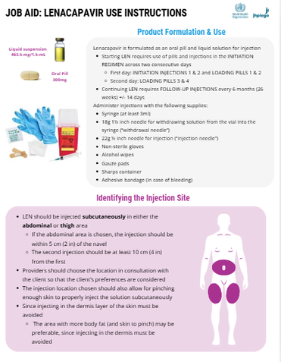
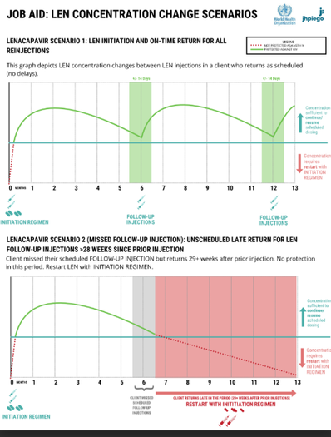
Downloadable Resources for Lesson 3:
The content in this lesson is also covered through downloadable resources, which can be found here: Lesson 3 Job Aids
LEN Product Use Instructions
LEN Concentration Change Scenarios

Slide 117
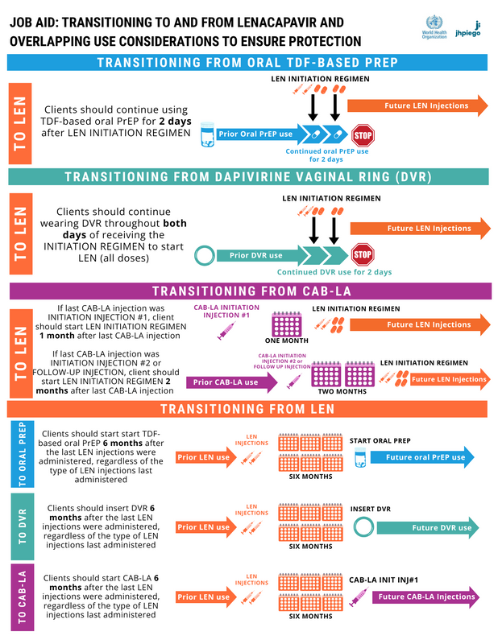
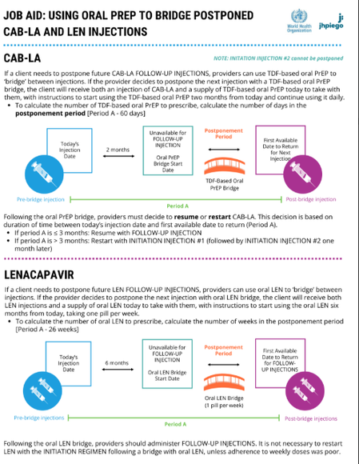
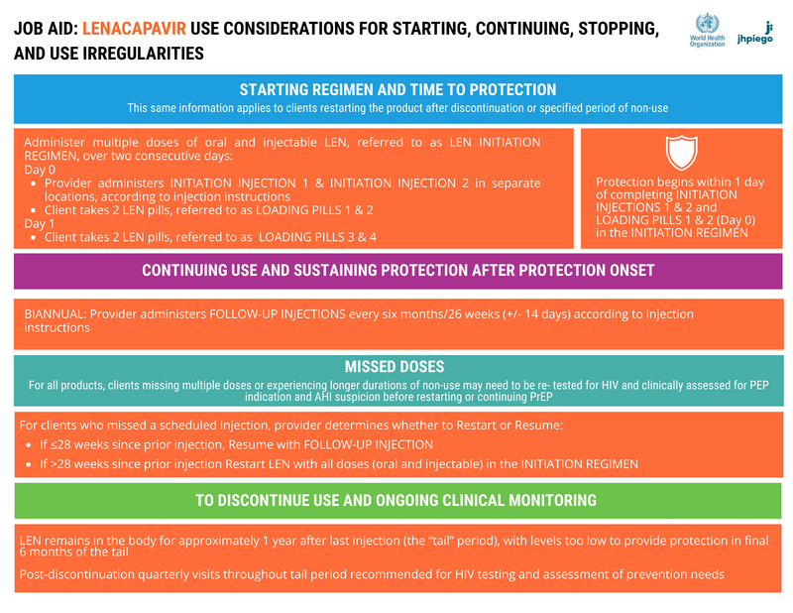
Downloadable Resources for Lesson 3: Continued
The content in this lesson is also covered through downloadable resources, which can be found here: Job Aids
Transitioning to and from LEN and overlapping use considerations
Using Oral PrEP to Bridge Postponed LEN & CAB-LA Injections
Lenacapavir Use Considerations for Starting, Continuing, Stopping, and Use Irregularities

Slide 118
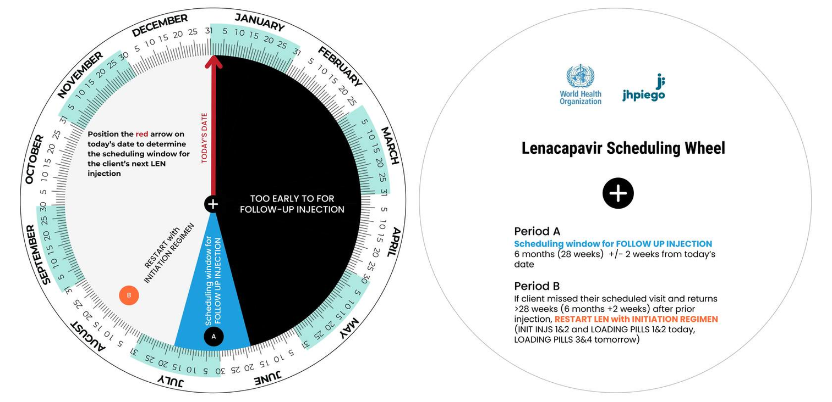
Downloadable Resources for Lesson 3: Continued
Printable Scheduling Wheels are available to assist in scheduling routine appointments and managing missed visits for LEN.

Slide 119

Downloadable Resources for Lesson 3: Continued
Interactive clinical tools (including digital scheduling assistant) is available on the HIV PrEP Provider App.

Slide 120

Provider Training Toolkit on Use of Oral and Long-acting HIV Pre-Exposure Prophylaxis (PrEP)
LESSON 4: LEN FOLLOW-UP CARE AND SIDE EFFECTS ASSESSMENT & MANAGEMENT

Slide 121
LEARNING OBJECTIVES
Upon completion of Lesson 4, you should be able to:
Describe which aspects of a client’s health need to be reassessed at follow-up visits
Explain the importance of evaluating clients’ experiences using LEN since the prior visit and how use deviations relate to follow-up care
Identify special considerations for clients whose LEN use deviates from the recommended schedule
Identify contraindications to continued LEN use and describe clinical management when contraindications exist
Describe how to assess and manage side effects and other complications

Slide 122
Evaluating the Client’s Experience Using LEN

Slide 123

How to determine whether a client has used LEN in a way that protects them against HIV
Clients should be continuously supported to use LEN effectively, since missed or delayed doses can reduce protection against HIV.
Eligibility assessment steps and clinical management at follow-up visits will vary according to whether LEN was taken as directed
Providers should routinely evaluate LEN dosing deviations at follow-up, which is particularly important in determining whether PEP may be indicated or AHI should be suspected.

Slide 124

How should returning clients be assessed as part of follow-up PrEP care?
All clients who start a PrEP product require ongoing follow-up care, as addressed in Lesson 3.
Many of the same eligibility assessment steps completed at the PrEP initiation visit (covered in Lesson 2) need to be re-assessed during follow-up visits.
This is because circumstances may change over time, and new contraindications, side effects and challenges with use may prevent continued use or warrant additional support.

Slide 125

Assessment Steps
While the assessment steps are the same regardless of the PrEP product being used, there are some unique aspects at follow-up visits (shown in italics below):
HIV Testing
Possible exposure to HIV in the past 72 hours (“PEP Assessment”), including assessment for PrEP use deviations
Signs/symptoms of acute HIV infection in past 2 weeks in the context of possible HIV exposure(s) in past 1 month ("AHI Assessment"), including assessment for PrEP use deviations
Use of other medications or products that may interact with PrEP
New medication allergies/hypersensitivities
New or changes in comorbidities
Side effects from use of PrEP
Additional details are provided below about ruling-out HIV infection through steps 1-3, with new instructions specifically for the PEP and AHI assessment steps.

Slide 126
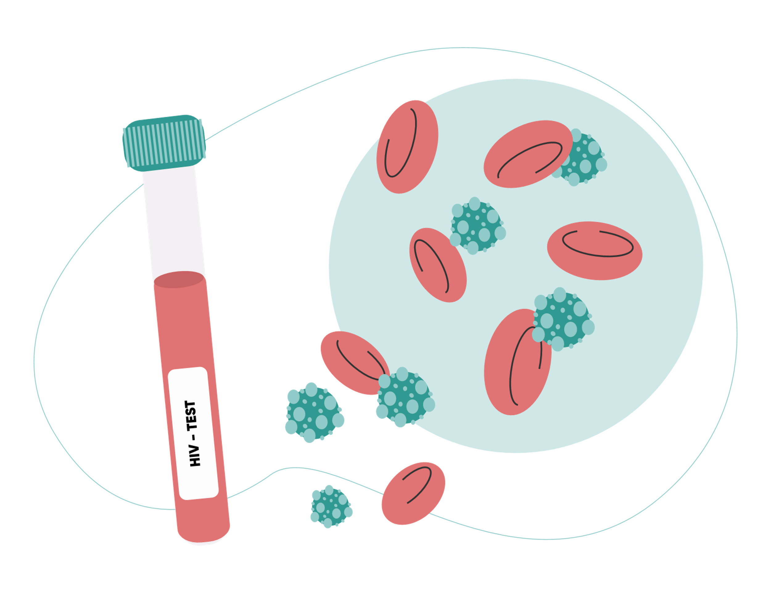
First a Reminder About Steps #1-3: Ruling-out HIV Infection
HIV Testing
PEP Assessment
AHI Assessment
Similar to the situation for those newly starting PrEP, continued use of PrEP is only appropriate for those who are HIV-negative.
HIV testing alone is not sufficient to rule out HIV infection, underscoring the importance of also performing the PEP and AHI assessment steps above, and including the determination of any PrEP use deviations/significance.
Note: Clinical management of those with a high PEP indication or a high suspicion of AHI varies by PrEP product.

Slide 127
Inadvertently starting or continuing PrEP use in individuals living with HIV may result in delayed start of ART, delayed detection of HIV by HIV tests, and risk of developing viral drug resistance.

Slide 128
PrEP Use Deviations and Eligibility to Continue PrEP
The PEP and AHI assessment steps conducted at follow-up visits must include an additional evaluation component: whether deviations in PrEP use occurred since the last visit (i.e. missed oral doses of TDF-based PrEP, days not wearing the DVR, delayed return for reinjection of CAB-LA or LEN).
Why is this necessary?
Clients who have been using PrEP effectively/as instructed (without significantly deviating from recommended dosing schedules) should have been maximally protected against HIV by PrEP.
This means there is unlikely to be a high indication for PEP or high suspicion of AHI, regardless of clients’ behavioral factors and signs/symptoms, and continued use of the PrEP product is probably appropriate.
Clients who experienced significant PrEP use deviations (e.g. missed or delayed PrEP doses or periods when PrEP wasn’t used) may not have been protected against HIV by PrEP.
This means PEP use may be indicated (instead of continuing PrEP), or AHI may be suspected (warranting a pause in the use of PrEP, at least temporarily).

Slide 129
Clients who return on-time for reinjection of LEN are considered to be using PrEP effectively (as instructed)
L
Providers should be able to easily check the date of the last injection to determine whether a client has returned late (also called delayed return and use deviation) for reinjection of LEN.

Slide 130
What is a “significant” deviation in PrEP use?
For injectable PrEP products (CAB-LA and LEN), significant use deviations/delays in reinjection are well defined, however, there is no single answer to this question for TDF-based oral PrEP and DVR
The more often and/or longer a client went without using these around the time of possible HIV exposure(s), the more significant the use deviation.
Significant PrEP use deviations may result in clients being less protected against HIV.
Since the assessments for PEP and AHI are related to possible HIV exposures occurring over different time periods (prior 72 hours for PEP; prior 1 month for AHI), the relevant time periods for assessing PrEP use deviations vary for each assessment step.
Each PrEP product has a unique use schedule that is recommended, and so definitions of significant use deviation also vary by product.

Slide 131
PrEP Use Deviations & PEP Assessment
Determining whether PEP is indicated involves a case-by-case clinical judgement call based on the likelihood that HIV exposure occurred in the prior 72 hours, primarily related to behavioral factors associated with risk of acquiring HIV. In clients returning for follow-up, a PEP indication also depends upon the client’s reported PrEP use, specifically whether there were days when PrEP wasn’t used but was needed due to potential exposure to HIV.
In returning clients, PEP indications are a gradient from low to high, with PEP more highly indicated in those with:
Higher-risk exposures, factoring details like condom use, type of sex, type and HIV status of partner(s); AND
Significant use deviations, factoring details like the duration PrEP was not used in relation to the possible exposure event in the past 72 hours
”Significant” deviations - when the client more frequently missed doses/went longer without using PrEP, or was delayed in returning for reinjection, and this coincided with the possible exposure event in the prior 72 hours. This may result in reduced or no protection against HIV at the time.

Slide 132
PrEP Use Deviations & PEP Assessment
If a client has not had a possible exposure in the prior 72 hours or has used PrEP without deviation, then nothing additional is required as part of the PEP assessment step; PEP is likely not indicated.
However, if a provider identifies a possible high-risk exposure event in the prior 72 hours in a returning client, they should next assess for significant deviations in PrEP use coinciding with the exposure.
As noted previously, significant use deviations in clients with higher-risk exposures may result in a higher indication for PEP. Product-specific considerations for conducting PEP assessment at follow-up visits are presented next.

Slide 133
LEN: Injection Delays & PEP Assessment
L

Slide 134
LEN: Injection Delays & PEP Assessment
L
REMINDER: if the client is not delayed in returning for LEN reinjection (i.e. returning on schedule), PEP assessment should be unnecessary.
In a LEN client who has returned late, if you identify a possible high-risk exposure event in the past 72 hours, next assess whether the delay (use deviation) is significant, which depends on the duration since the last injection:
For clients delayed in returning for a FOLLOW-UP INJECTION, if > 28 weeks (6 months + 14 days) have passed since the prior injection, the deviation is significant, and in a client with a higher-risk exposure coinciding with the delay, may warrant starting PEP.

Slide 135
LEN: Injection Delays & PEP Assessment
L
REMINDER: if the client is not delayed in returning for LEN reinjection (i.e. returning on schedule), PEP assessment should be unnecessary.
For clients starting PEP, LEN should be stopped, with the option to restart LEN after completing PEP and retesting for HIV in 1 month.
Remember, those with higher-risk exposures and significant use deviations likely have a higher indication for PEP, and providers will need to make decisions on a case-by-case basis, taking into consideration all of the relevant details.
For complex cases, it may be helpful to use a printed calendar to note the date of the possible exposure event in the past 72 hours and the duration elapsed since prior injection.
Note: if PEP is not indicated and a client wishes to continue using LEN, but > 28 weeks elapsed since prior LEN injection, LEN must be restarted by administering all oral and injectable doses over two consecutive days in the INITIATION REGIMEN.

Slide 136
USE DEVIATIONS & AHI ASSESSMENT

Slide 137
PrEP Use Deviations & AHI Assessment
Now that we’ve covered the importance of PrEP use deviations as part of PEP assessment, we’ll consider use deviations in assessing for suspicion of AHI.
Determining whether AHI is suspected involves a case-by-case clinical judgement call based on AHI-like signs/symptoms (past 2 weeks) and the likelihood of HIV exposure (past 1 month). In clients returning for follow-up, whether AHI is suspected also depends on the client’s reported PrEP use, specifically whether there were days when PrEP wasn’t used.
In contrast to the PEP assessment step—where the focus was on possible HIV exposure in the prior 72 hours—the relevant period of possible HIV exposures for AHI assessment is 1 month.
Thus, providers must evaluate the client’s PrEP use history over a longer timeframe and determine days/periods when PrEP was/wasn’t used coinciding with all possible HIV exposures throughout the prior month. It should be acknowledged that clients may have difficulty recalling details over such an extended period.

Slide 138
PrEP Use Deviations & AHI Assessment
In returning clients, suspicion of AHI is a gradient from low to high, with a higher suspicion of AHI in those with:
AHI-like signs/symptoms in context of higher-risk exposures, factoring details like condom use, type of sex, type, HIV status of partner(s); AND
Significant use deviations, factoring details like duration PrEP was not used in relation to each possible exposure event in the past 1 month
“Significant” deviations would be those occurring when the client more frequently missed doses/went longer durations without using PrEP coinciding with each possible exposure, potentially resulting in reduced or no protection against HIV throughout the prior month.

Slide 139
PrEP Use Deviations & AHI Assessment
If a client does not have/has not had AHI-type signs or symptoms (past 2 weeks) or possible HIV exposure (past 1 month), or has used PrEP without deviation in the period, then nothing additional is required as part of the AHI assessment step; there would likely be no suspicion of AHI.
However, if a provider identifies relevant signs/symptoms/exposure(s) in a returning client, they should next assess for significant deviations in PrEP use. As noted previously, the more often and/or longer a client went without using PrEP around the time of each possible HIV exposure in the prior month, the more significant the use deviation(s) and the higher the suspicion of AHI.
Product-specific considerations for conducting AHI assessment at follow-up visits are presented next.

Slide 140
LEN: Injection Delays & PEP Assessment
L

Slide 141
LEN: Injection Delays & AHI Assessment
L
REMINDER: if the client is not delayed in returning for LEN reinjection (i.e. returning on schedule), AHI assessment should be unnecessary.
In a LEN client who has returned late, if you identify AHI-like signs/symptoms in the past 2 weeks and possible high-risk exposure(s) in the past 1 month, next assess the significance of the delay/use deviation, which depends on the duration since the last injection, as follows:
For clients delayed in returning for a FOLLOW-UP INJECTION, if > 28 weeks (6 months + 2 weeks) have passed since the prior injection, the deviation may be significant enough to warrant pausing LEN pending HIV retesting). The longer the delay, the more significant the use deviation.

Slide 142
LEN: Injection Delays & AHI Assessment
L
REMINDER: if the client is not delayed in returning for LEN reinjection (i.e. returning on schedule), AHI assessment should be unnecessary.
Providers will need to make decisions on a case-by-case basis, taking into consideration all relevant details to determine whether a delayed return for reinjection was significant enough to warrant pausing use of LEN pending HIV retesting.
Remember, those with AHI-like signs/symptoms who had higher-risk exposures and more significant use deviations would likely warrant a higher clinical suspicion of AHI.
For complex cases, it may be helpful to use a printed calendar to note the dates of the possible exposure events throughout the prior month and the duration elapsed since prior injection.
Note: if AHI is not suspected and a client wishes to keep using LEN, if > 28 weeks elapsed since prior LEN injection, LEN must be restarted by administering all oral and injectable doses over two consecutive days in the INITIATION REGIMEN

Slide 143
Identify Contraindications

Slide 144
Contraindications/Considerations for Continued Use – All PrEP Products
Some contraindications apply to continued use of all PrEP products, and some are product-specific.
We’ll first review those contraindications that apply to all products.

Slide 145
Continued use of any PrEP product would be contraindicated in clients with:
HIV (including inconclusive HIV status)
Clients with reactive HIV test(s) should have the diagnosis confirmed and be referred for initiation of HIV antiretroviral therapy (ART) in accordance with national guidelines. Do not continue PrEP in clients with a confirmed HIV diagnosis or use PrEP and ART together.
Clients with an inconclusive HIV test result should be re-tested for HIV according to national guidelines. PrEP use should be paused while re-testing is completed and alternative HIV prevention strategies suggested in the interim.
High PEP Indication
In clients with a high indication for PEP, based on exposure event risk level and significant use deviations, consider stopping PrEP and switching to a 1-month course of PEP. Clients with an HIV-negative test at 1 month, may immediately transition back to PrEP without a break if clinically eligible for PrEP.
Note: Providers should assess the risks and benefits of switching a client from PrEP to PEP. For example, providers should consider client motivation to take PEP every day for one full month, before making the decision to stop PrEP and start PEP.
Allergic reaction possibly or likely resulting from use of PrEP
Do not continue providing a PrEP product to a client who experienced an allergic reaction possibly or likely related to the medicine(s) in that particular PrEP product. An alternative PrEP product or HIV prevention strategy may be suitable instead.

Slide 146
We’ll now review the LEN-specific contraindications and considerations to continued use.
When a contraindication or special consideration exists, clinical management options and alternatives are suggested

Slide 147
Contraindications & Considerations: LEN
L
In addition to the contraindications listed above for all PrEP products (positive or inconclusive HIV status, high indication for PEP, allergy to PrEP medication), the following contraindications and considerations to continued use of LEN apply:
High suspicion of AHI, based on signs/symptoms/exposure history and significance of use deviations.
Medication interactions: Use of medications with lenacapavir drug-drug interaction , with contraindications and considerations varying by medication

Slide 148

Contraindications & Considerations: LEN
L
High Suspicion of AHI
Consider pausing the use of LEN and advise the client to return for HIV retesting in 1 month. Clients may restart LEN if results of HIV retesting in 1 month are negative. Alternative HIV prevention strategies should be chosen during the period when LEN use is paused.
The potential risks and benefits of pausing vs. continuing LEN should be made on a case-by-case basis, with a pause chosen only when the risks of potentially continuing LEN during AHI are deemed to outweigh the possible benefits of continued use to prevent HIV.

Slide 149
Contraindications & Considerations: LEN
L
Medication Interactions
There are no contraindications to using LEN due to use of other medications
Use of any of the following medications concomitantly with LEN or in the months after LEN discontinuation may require a dose adjustment (to the dose of either LEN or the other medication
Rifabutin
Rifampicin
Rifapentine
Carbamazepine
Phenobarbital
Prescribers should review the regulatory labels of both medications when being prescribed for concomitant use or when the other medication is used after LEN has been discontinued.
Different PrEP or HIV prevention options may be possible alternatives if LEN injections are discontinued.
LEN is not expected to interact with gender-affirming hormones based on the limited evidence available.
A note about medication use during pregnancy: LEN is not known to interact with medications or dietary supplements commonly used during pregnancy and the postnatal period, including iron and folic acid tablets, antibiotics, antimalarials, antihelminthics, oxytocin, and contraception.
Phenytoin
Ketamine
Avanafil
Sildenafil
Tadalafil

Slide 150
Side Effects

Slide 151

How should side effects be assessed and managed?
All PrEP products may cause side effects.
These vary by product.
Providers should assess clients at follow-up visits for new side effects since the prior visits, including for side effects that may have resolved.

Slide 152

It should be noted that clients who are pregnant may experience headaches, dizziness, nausea and/or fatigue related to their pregnancy, and these symptoms are similar to side effects from use of some PrEP products.
Determining whether such symptoms are related to PrEP, pregnancy or both may be challenging.

Slide 153

Most side effects resulting from use of any PrEP product are rare, are mild-moderate, resolve on their own or with symptomatic management with non-prescription medications, and stopping PrEP use is usually not required.
Clients should be advised to seek immediate medical attention for signs or symptoms of an allergic reaction with the use of any of the PrEP products. These are non-specific and may include: rash, itching, swelling, or shortness of breath, among others.
Clients should also be advised to seek advice if they are concerned about any side effects they are experiencing.

Slide 154
Side Effects: LEN
L
The following side effects, typically mild to moderate in severity, may occur among those receiving LEN injections:
Injection site reactions (Pain, Swelling, Nodules, Induration (thickening/hardening of tissue at injection site), Redness/bruising, Itching)
Headache
Diarrhea
Nausea
Tiredness
Of those listed, the most common side effects are injection site reactions, including nodules, which may have resulted from the subcutaneous LEN depot formed at the injection site. Both nodules and indurations may resolve more slowly than other injection site reactions (e.g. from several months to more than a year). Nodules may not be visible but may be easily felt.
Injection site reactions may be minimized by use of ice/cold compresses applied to both injection sites and use of NSAIDs before and/or after each injection. Application of topical analgesics to both injection sites 30 minutes prior to injection may also reduce symptoms.
Other side effects can often be managed symptomatically, usually with non-prescription medicines when indicated, and typically resolve without the need to discontinue LEN.
Clients should be advised to contact their provider if symptoms are severe or prolonged, or if they’re concerned.

Slide 155
A final note about safety of HIV PrEP in pregnancy
While all PrEP products are considered safe for use in pregnancy by WHO, it remains important for programs and providers to collect and share information on any concerning pregnancy and birth outcomes arising, as the number of pregnant users of these products increases. This is especially the case for long-acting products like LEN, since it is relatively newer and have thus been used by fewer people to date.

Slide 156
A final note about safety of HIV PrEP in pregnancy
Providers prescribing LEN to clients who are or become pregnant are encouraged to actively report pregnancy and birth outcomes in clients who have used these products prior to or during pregnancy, through the Antiretroviral Pregnancy Registry (APR).
The WHO APR Toolkit provides guidance for key maternal and birth/infant outcomes for reporting purposes, focusing on standardization, data quality and harmonization of outcomes to allow collaboration and linkage between surveillance networks. The toolkit also provides links to study materials from key pregnancy and birth surveillance studies and registries.

Slide 157
Summary of Key Points in Lesson 4
Returning PrEP clients should be reassessed to determine any new contraindications arising. To determine whether a client is clinically eligible to continue using PrEP, providers should conduct the following assessments:
HIV Testing
Possible exposure to HIV in the past 72 hours (“PEP Assessment”), including assessment for PrEP use deviations
Signs/symptoms of acute HIV infection in past 2 weeks in the context of possible HIV exposure(s) in past 1 month ("AHI Assessment"), including assessment for PrEP use deviations
Use of other medications or products that may interact with PrEP
New medication allergies/hypersensitivities
New or changes in comorbidities
Side effects from use of PrEP

Slide 158
Summary of Key Points in Lesson 4
As part of the PEP and AHI assessment steps, provider must assess whether clients missed PrEP doses/had periods of non-use (deviated from the dosing schedule) or used PrEP effectively/as instructed. PrEP use deviations may have resulted in the client being less protected against HIV.
Side effects due to the use of PrEP (regardless of the product) are typically of mild-moderate severity, often resolve on their own or with symptomatic management with non-prescription medications, and stopping PrEP use is usually not required. Clients should be advised to contact their provider if symptoms are severe, prolonged or if they’re concerned.
Clients experiencing signs/symptoms of an allergic reaction—such as rash, itching, swelling or shortness of breath—should seek immediate medical attention.

Slide 159
Summary: Contraindications/Considerations to LEN use
Some contraindications only pertain to LEN clients with deviations in use (delays between injections), which are noted in italicized text below, while others apply to all LEN users.
Contraindications/considerations to continued use of LEN are as follows:
HIV-positive or inconclusive results
Discontinue LEN; refer for ART
High indication for PEP (high-risk exposure and significant LEN use deviation/injection delay)
Consider discontinuing LEN and starting 1-month course of PEP, after assessing likelihood of PEP adherence/completion
High suspicion of AHI (signs/symptoms/exposure history and significant use deviation/ injection delay)
Consider pausing LEN pending retesting for HIV in 1 month, after weighing risks/benefits of pausing/continuing
Medication interactions
There are no contraindications to using LEN due to use of other medications.
Use of any of the following medications concomitantly with LEN or in the months after LEN discontinuation may require a dose adjustment (to the dose of either LEN or the other medication):
Rifabutin
Rifampicin
Rifapentine
Carbamazepine
Prescribers should review the regulatory labels of both medications when being prescribed for concomitant use or when the other medication is used after LEN has been discontinued.
Allergic reaction to lenacapavir/LEN injection
Discontinue LEN; an alternative PrEP product may be suitable
Phenobarbital
Phenytoin
Ketamine
Avanafil
Sildenafil
Tadalafil
Vardenafil

Slide 160
Summary: LEN Side Effects
The following side effects, typically mild to moderate in severity, may occur among those receiving LEN injections:
Injection site reactions
Nodules
Pain
Redness/bruising
Induration
Swelling
Itching
Headache
Nausea
Diarrhea
Tiredness
Injection site reactions are the most common side effects and may be minimized by use of ice/cold compresses and NSAIDs before and/or after injections. Nodules and indurations may persist for longer than other injection site reactions.
Most other side effects are rare, mild, can be managed symptomatically with non-prescription medicines when indicated, and typically resolve without the need to discontinue LEN.

Slide 161
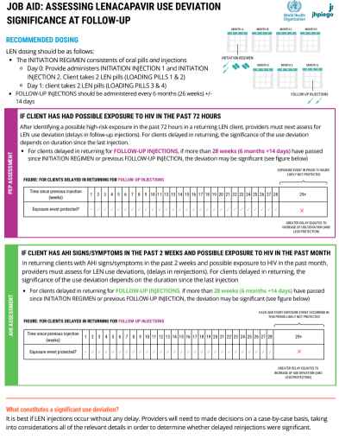
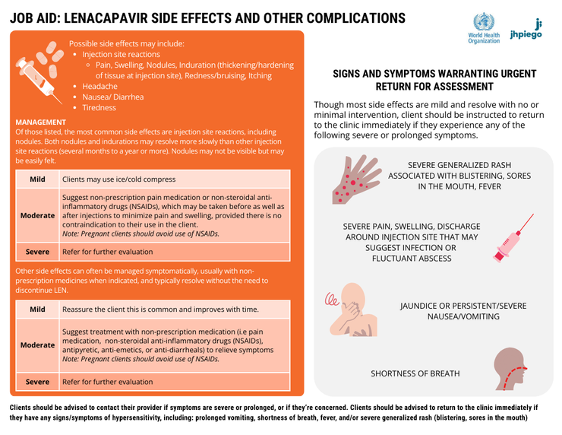
Downloadable Resources for Lesson 4:
The content in this lesson is also covered through downloadable resources, which can be found here: Lesson 4 Job Aids
Assessing LEN Use Deviation at Follow-Up
LEN Side Effects and Other Complications

Slide 162
Thank you!
For more information, visit: www.jhpiego.org/HIVPrEPtoolkit
This resource was made possible with support and technical contributions from Gilead Sciences, Inc., Viiv Healthcare, Population Council, the World Health Organization, Jhpiego, and the United States Government funded RISE program, under the terms of the cooperative agreement 7200AA19CA00003. The contents are the responsibility of Jhpiego and do not necessarily reflect the views of the United States Government.

